Slide 1
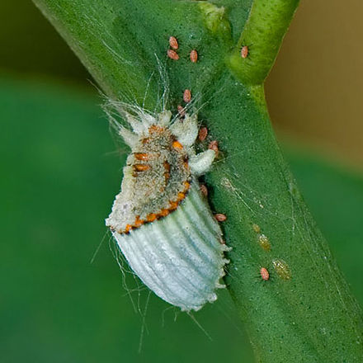
Arthropod Physiology
https://en.wikipedia.org/wiki/Scale_insect#/media/File:Scale_insect.jpg

Slide 2
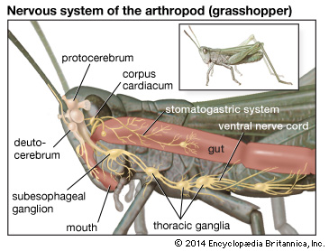
Insects
Open circulatory system
Complete digestive system
Nervous system: Dorsal brain, longitudinal nerve cord
Exoskeleton, Segmentation, and jointed appendages
https://media1.britannica.com/eb-media/38/73338-004-ED68E7FB.jpg

Slide 3
Hemiptera Physiology
Beak: modified from the mandibles and maxillae
Used for piercing and sucking liquids from food
The forewings are either entirely membranous or partially hardened
Tymbals: are drumlike disks of cuticle
https://pestsandpollinators.files.wordpress.com/2015/10/rostrums.png

Slide 4
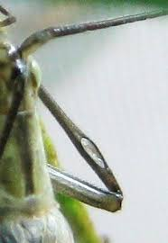
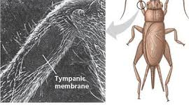
Tympanic membrane
http://3.bp.blogspot.com/_hhUdKwzDmA4/S4P5jADxC3I/AAAAAAAAAd8/RD1IvGQssVY/s400/insect.jpg
http://www.oecanthinae.com/mediac/450_0/media/Hearing$20membrane$20on$20long$20female.JPG

Slide 5
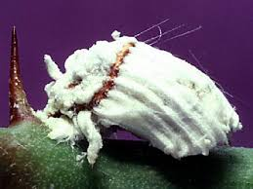
Hemiptera: Coccoidea (scale insects)
Scales grow beneath wax covers or exoskeleton covered in mealy wax
Wings are reduced almost to non-existence
Crawling legs
http://tolweb.org/tree/ToLimages/icerya-purchasi.250a.jpg

Slide 6
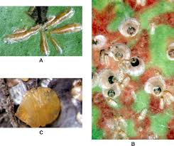
Waxy Scales
Used for defense against predators
Used for clinging onto leaf
Can be used as a form of water control
https://upload.wikimedia.org/wikipedia/commons/thumb/c/c0/Armored_scale_insects.png/1200px-Armored_scale_insects.png

Slide 7
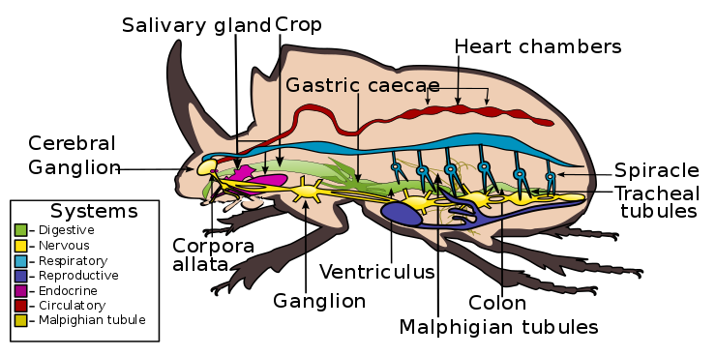
Coleoptera: Beetles
Digestive system: Crop
Tympanal organs: Skin stretched over air sac with sensory organs
Segmented tube heart attached to the dorsal wall
https://en.wikipedia.org/wiki/Beetle#/media/File:Internal_morphology_of_Coleoptera.svg

Slide 8
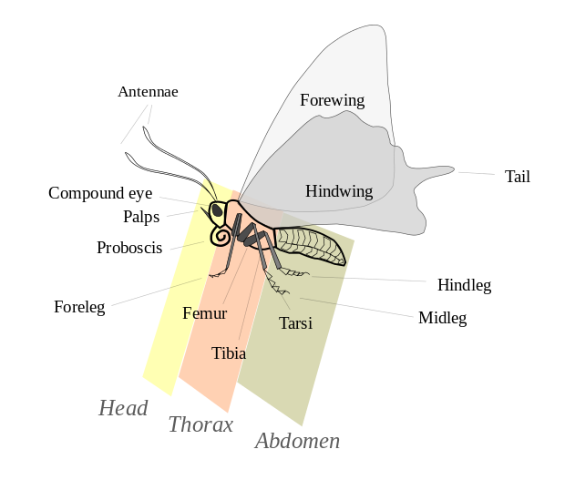
Lepidoptera: Butterfly
Scales on wings and appendages
Sclerotized head capsule
- toughened scales with two
compound eyes
Thorax is made of three fused segments
https://en.wikipedia.org/wiki/Lepidoptera#/media/File:Butterfly_parts.svg

Slide 9
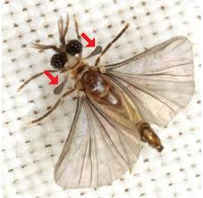
Diptera: Fly
One pair of fore wings, and another pair of halteres
Compound eyes and three ocelli
Claws and pads on their feet to cling to smooth surfaces
https://upload.wikimedia.org/wikipedia/commons/1/1d/Strepsiptera.png

Slide 10
Videos
https://www.youtube.com/watch?v=xYh5Csdf7lo
Video about insect external and internal structures and functions

Slide 11
Resources
https://www.slideshare.net/vicky14381/anatomy-physiology-of-arthropods
http://www.newworldencyclopedia.org/entry/Arthropod#Anatomy_and_physiology
https://en.wikipedia.org/wiki/Scale_insect#/media/File:Scale_insect.jpg
http://courses.lumenlearning.net/biology/wp-content/uploads/sites/5/2014/02/Figure_15_03_06.jpg
https://media1.britannica.com/eb-media/38/73338-004-ED68E7FB.jpg
https://en.wikipedia.org/wiki/Beetle#/media/File:Internal_morphology_of_Coleoptera.svg
https://en.wikipedia.org/wiki/Beetle#Anatomy_and_physiology
https://en.wikipedia.org/wiki/Scale_insect
https://en.wikipedia.org/wiki/Lepidoptera#/media/File:Butterfly_parts.svg
https://en.wikipedia.org/wiki/Lepidoptera
https://upload.wikimedia.org/wikipedia/commons/1/1d/Strepsiptera.png
https://en.wikipedia.org/wiki/Fly#Anatomy_and_morphology
https://en.wikipedia.org/wiki/Insect

