Slide 1
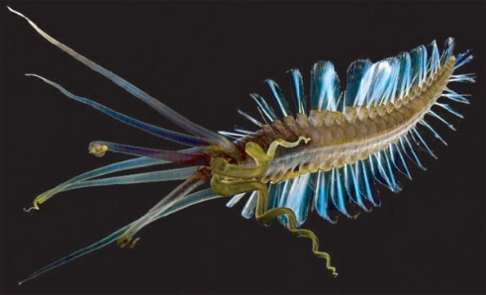
Annelida and Teuthidodrilus Reproduction
http://phenomena.nationalgeographic.com/2010/11/23/meet-the-squidworm-half-worm-half-squid-er-actually-all-worm/
By: Kimberly Cerilli

Slide 2
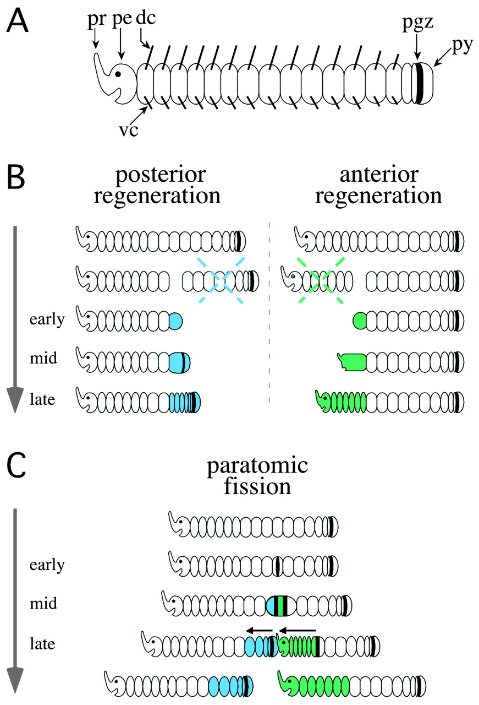
Phylum
Annelids: Segmented Worms
Asexual Reproduction
http://dev.biologists.org/content/128/14/2781

Slide 3
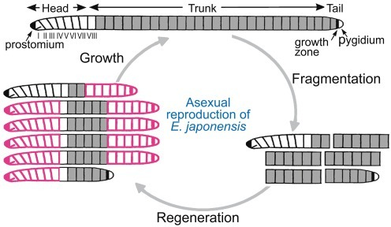
https://openi.nlm.nih.gov/imgs/512/368/3353931/PMC3353931_pone.0037319.g002.png
Some annelids reproduce only via asexual reproduction
Some annelids reproduce asexually in the summer and sexually in the autumn

Slide 4
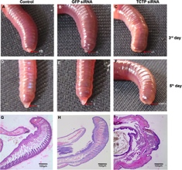
Regeneration
“Regeneration of heads and tails commonly occurs when an injury activates stem cells that differentiate into replacement parts.” - http://www.washingtonpost.com/wp-srv/special/metro/urban-jungle/pages/130604.html
http://journals.plos.org/plosone/article/figure/image?size=inline&id=10.1371/journal.pone.0175319.g008

Slide 5
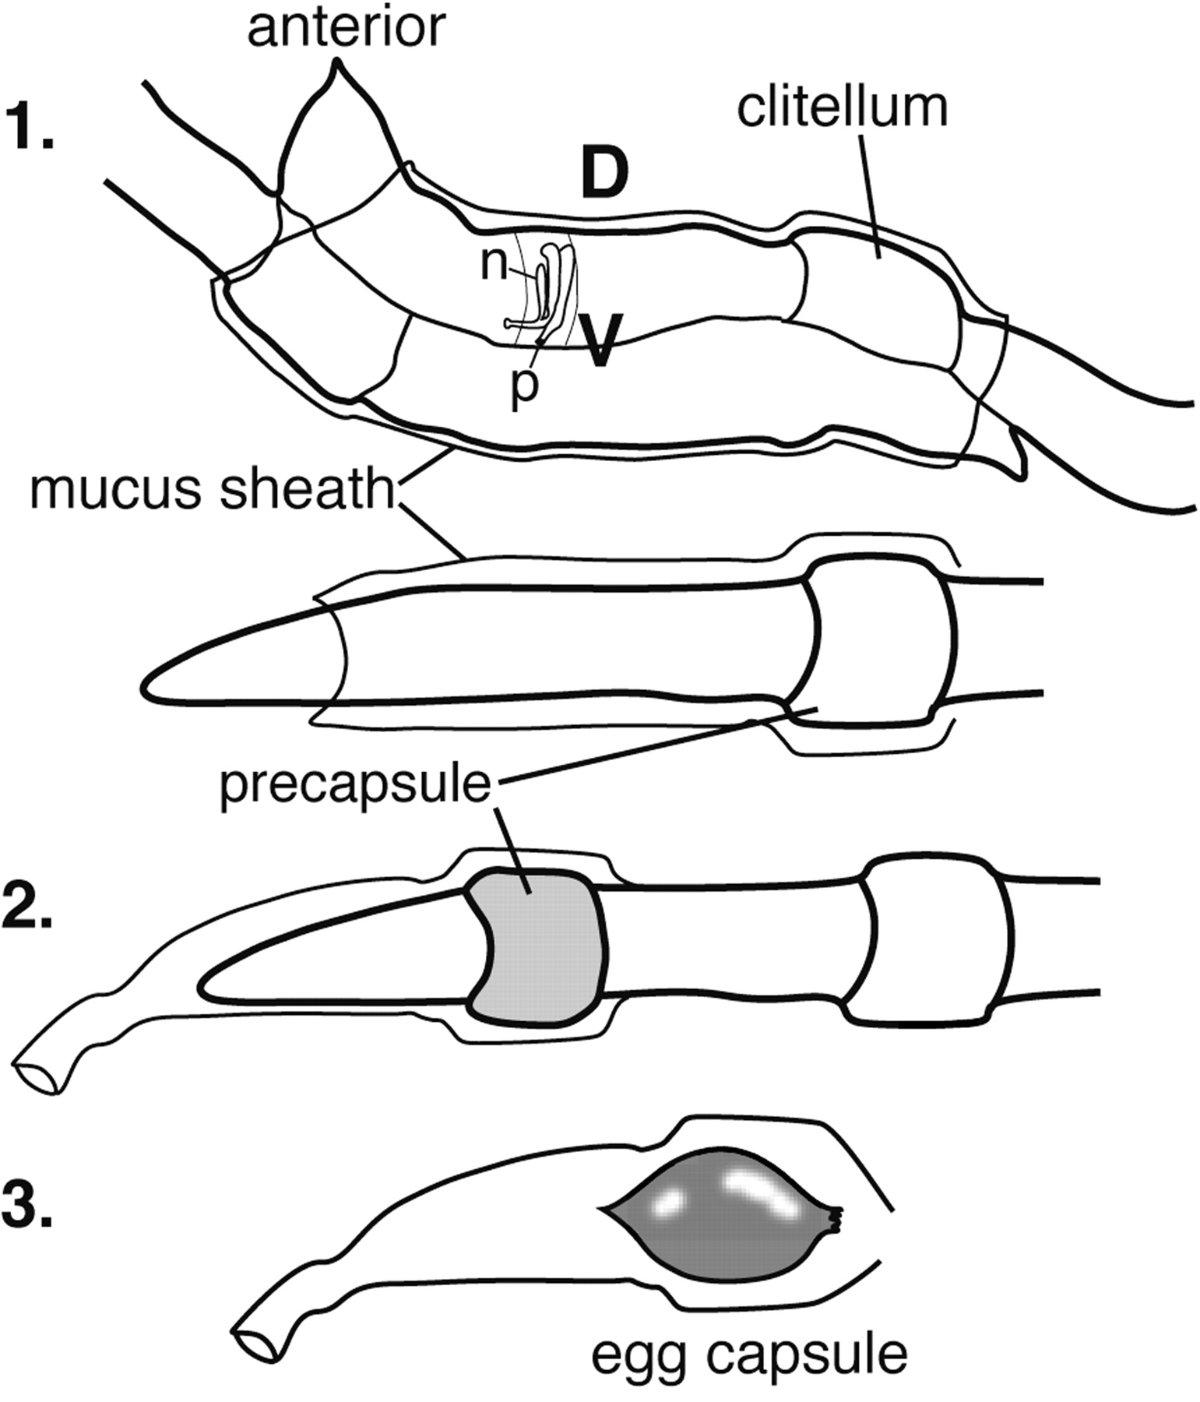
Annelid:
Sexual Reproduction
http://aem.asm.org/content/72/1/769/F2.expansion.html

Slide 6
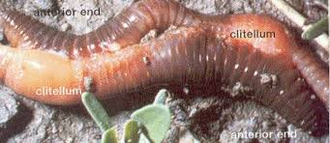
http://images.tutorvista.com/content/diversity-living-world/earthworm-structure.jpeg
Thought that annelids were originally animals with two sexes.
Later became more hermaphroditic.
Sperm can be deposited via a penis or just ejaculated into the water.

Slide 7
Class
Polychaete: Bristle Worms
Asexual reproduction
http://slideplayer.com/slide/3434084/

Slide 8
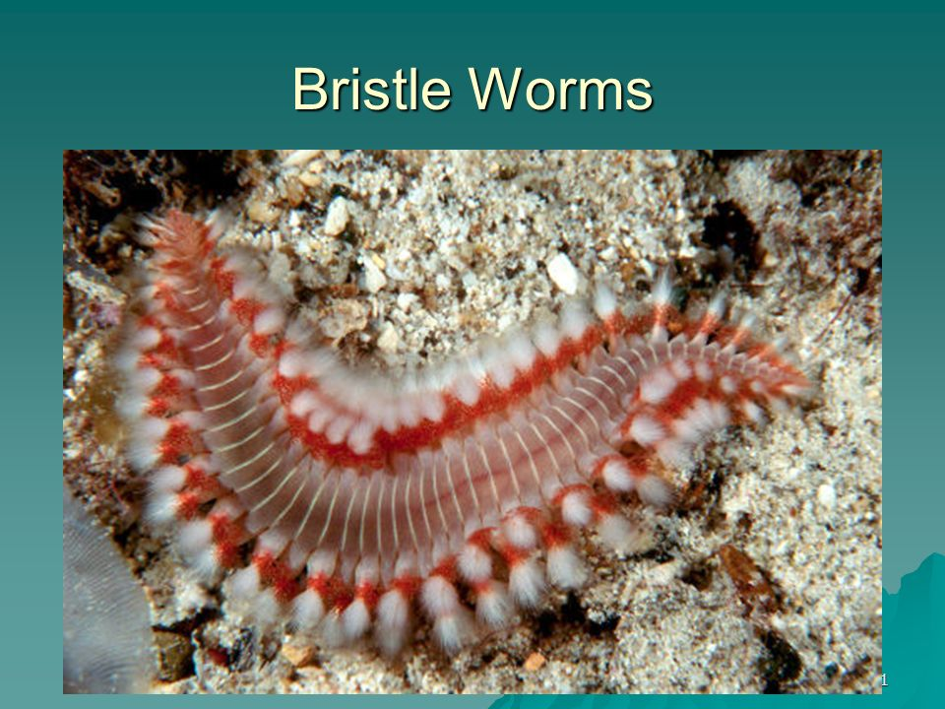
http://images.slideplayer.com/36/10585874/slides/slide_11.jpg
Class Polychaetes can reproduce asexually by budding or dividing into pieces.
Some species (Eunicie) look like burrow-dwelling polychaete, but during the mating seasons the worm grows a specialized segment. The front half (atoke) of the worm is asexual and the the back half is sexual.

Slide 9
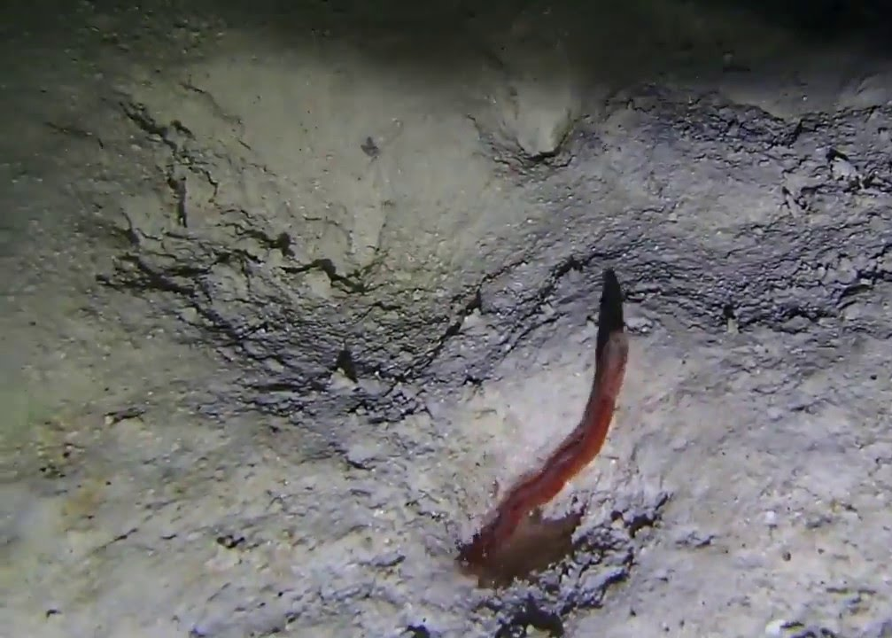
Polychaete: Sexual Reproduction
Epitoke
https://www.youtube.com/watch?v=V4VLtmCoMj8

Slide 10
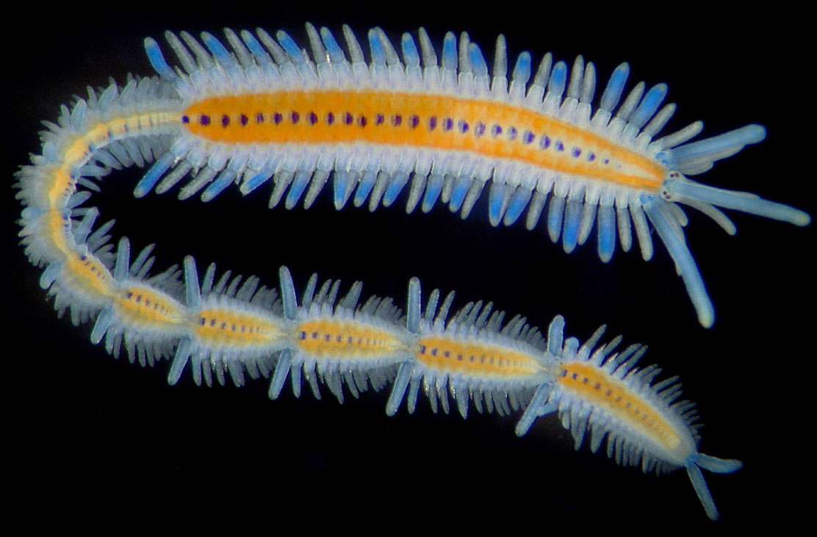
Most Polychaetes have separate sexes rather then being hermaphroditic.
In the epitokes side The gonads shed immature gametes into the body cavity where they complete development.
When mature the gametes are shed threw pores
Some species die from the shedding of gammetes as it rips threw their body walls
Fertalized eggs hatch into trochophore (free living planktonic) larvae.
Metamorph in to adult and start adding segments.
In rare cases there is no larval stage and the egg instead has a yolk which is fed off of then the worm hatches as a mini adult.
http://invertebrates.si.edu/Features/images/families/polychaeta/myrianida.jpg

Slide 11
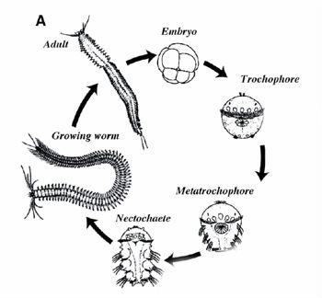
http://sunny.moorparkcollege.edu/~econnolly/wormsX3_files/image036.gif
Notes:
Polychaete Life cycle

Slide 12
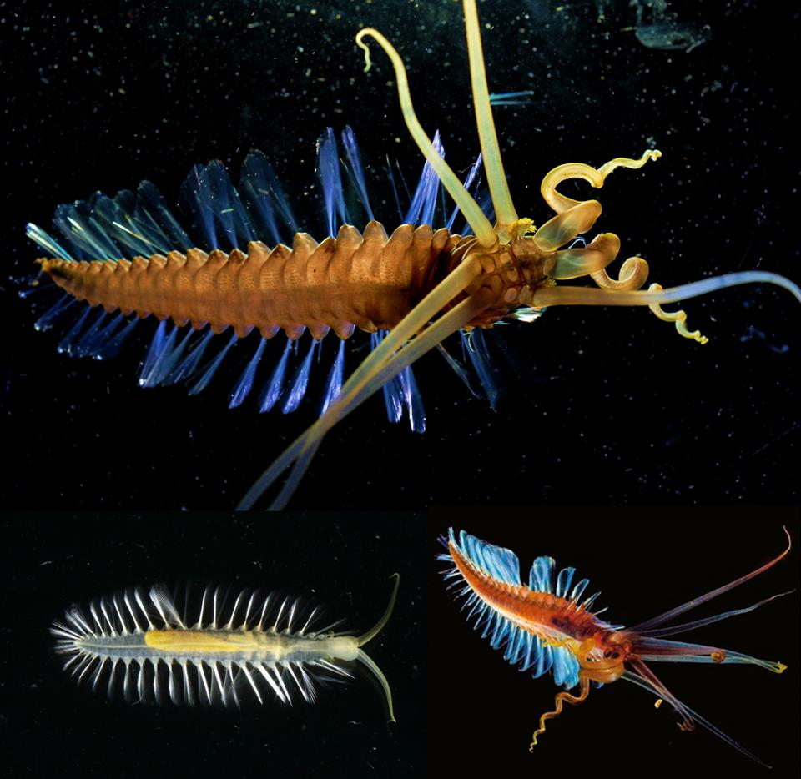
Teuthidodrilus: Squidworm
Reproduction?
Will probably be able to do asexual and
sexual reproduction
More then likely uses a epitoke to reproduce
Possibly uses nuchal organ that senses smells
and taste to help find possible mating partner
http://madasamarinebiologist.com/post/41187379156/squidworm

Slide 13
Reference
http://phenomena.nationalgeographic.com/2010/11/23/meet-the-squidworm-half-worm-half-squid-er-actually-all-worm/
http://dev.biologists.org/content/128/14/2781
http://aem.asm.org/content/72/1/769/F2.expansion.html
http://slideplayer.com/slide/3434084/
https://www.youtube.com/watch?v=V4VLtmCoMj8
http://sunny.moorparkcollege.edu/~econnolly/wormsX3_files/image036.gif
http://madasamarinebiologist.com/post/41187379156/squidworm
https://www.insidescience.org/news/bizarre-squidworm-discovered
https://en.wikipedia.org/wiki/Annelid#Reproduction_and_life_cycle
https://en.wikipedia.org/wiki/Polychaete#Reproduction
https://en.wikipedia.org/wiki/Teuthidodrilus

