Slide 1
Sarah Gorges
Digital Painter and Illustrator

Slide 2
Portrait Painter

Slide 3
Connections
Connections is a series of digital paintings about the relationships I have with my friends. Each of my friendships are different and special. I see each person in a different light than the others. One of the pieces is a self-portrait on how I see myself and the other [7] are of close friends. I want people to be able to know my friends without actually knowing them. I acquired pictures of my friends and myself by asking them for their favorite selfie which often was done by snapchat. I then went on to create a limited color palette that ranges from 6-8 colors that I feel represents their energy and how I see them in my life. Some people are bolder, so more intense colors were used while some people were more chill, so I used desaturated colors. I developed a technique and style that utilizes a charcoal brush with Photoshop's mixing brush tool. The backgrounds were created using a simple image that I feel describes them along with blending modes to create a layered effect that also reflects them.

Slide 4
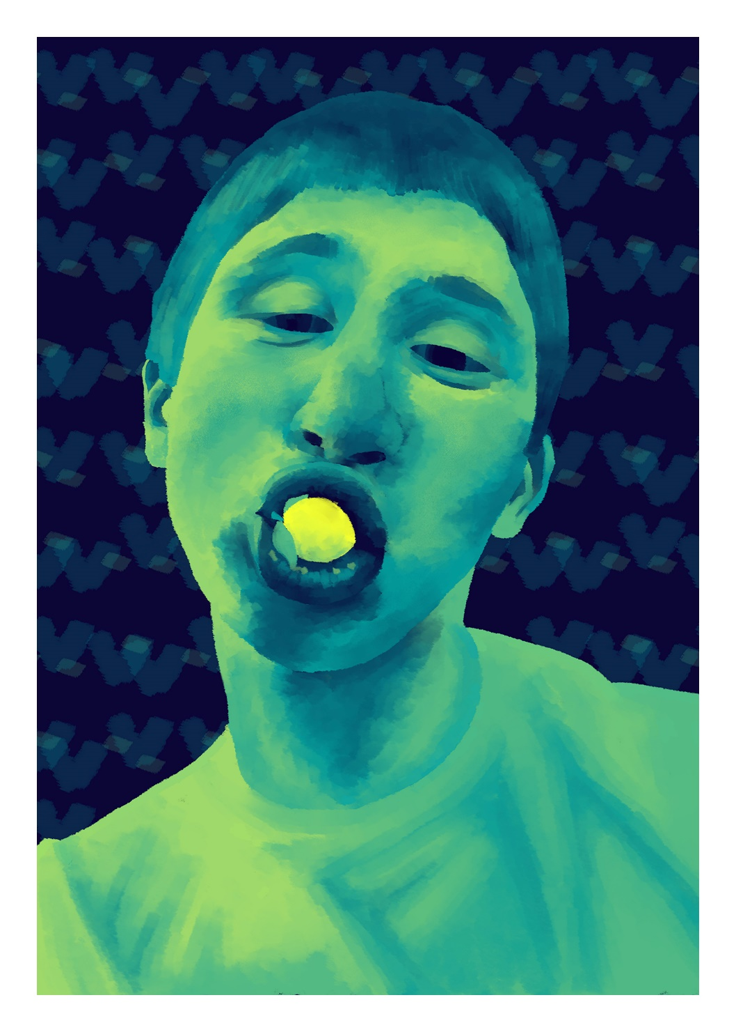

Slide 5
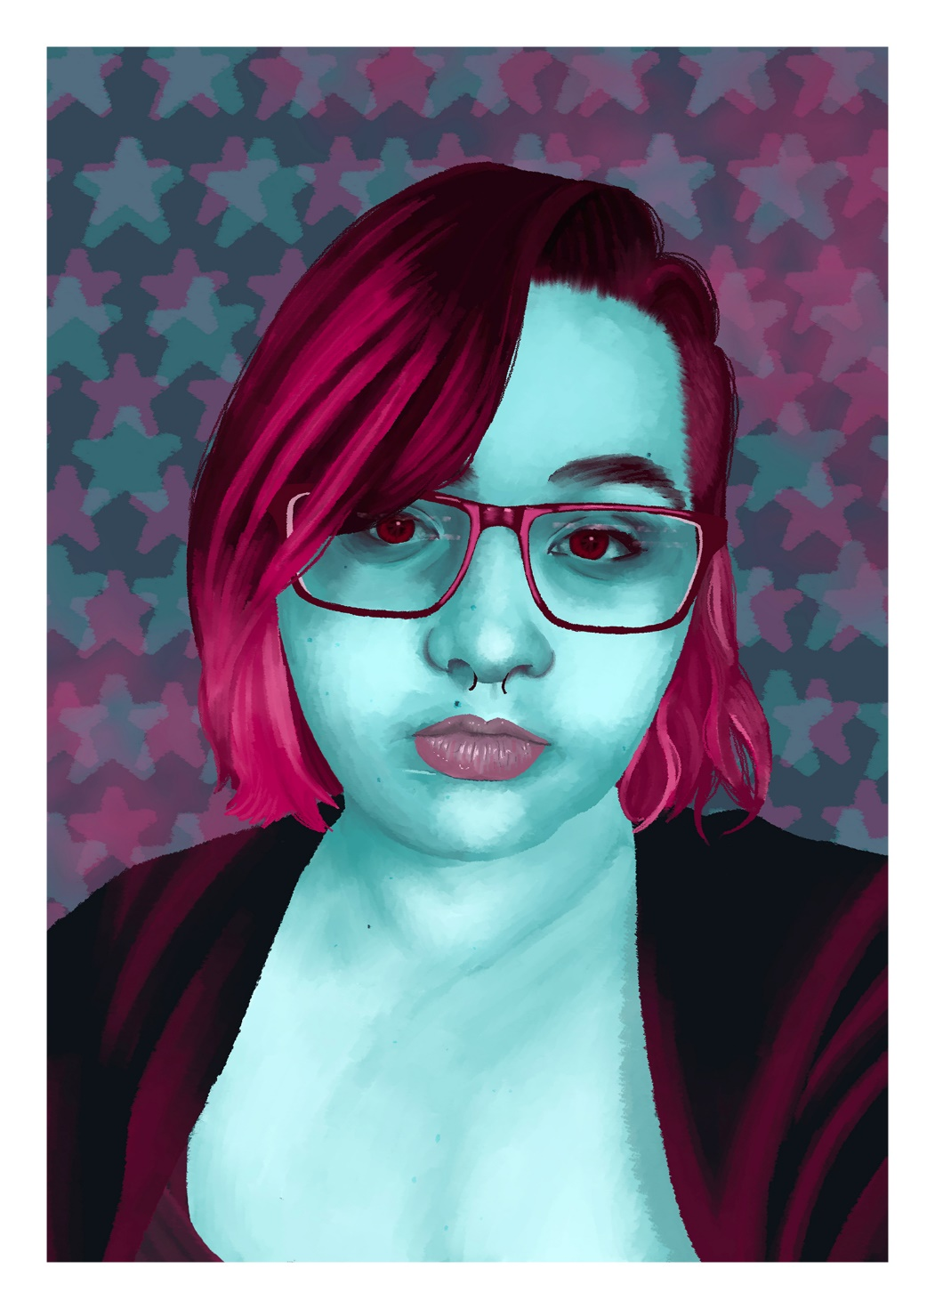

Slide 6
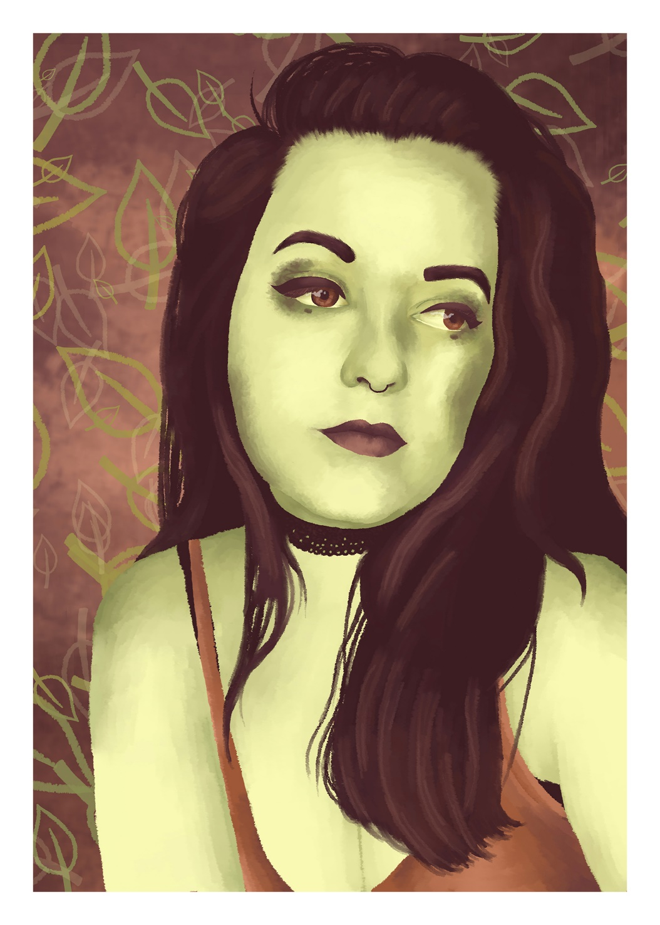

Slide 7
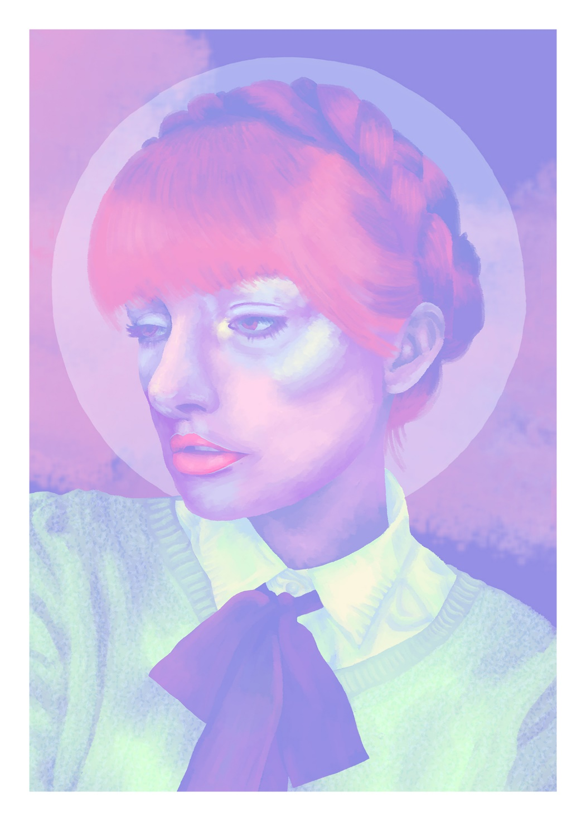

Slide 8
Illustrations

Slide 9
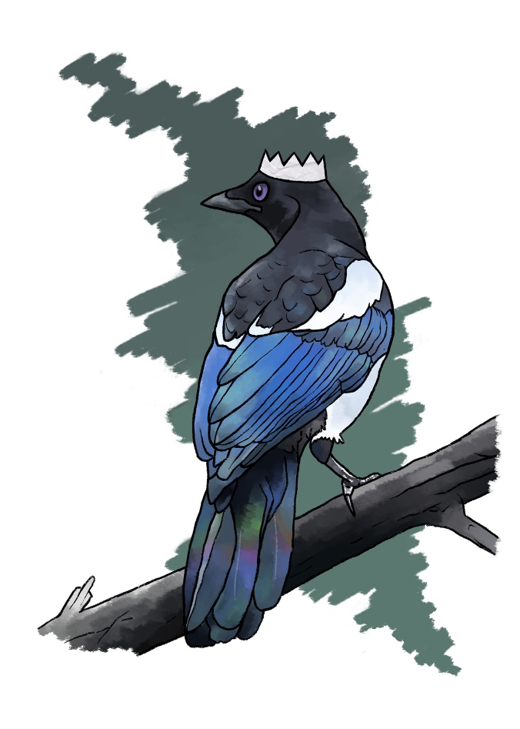
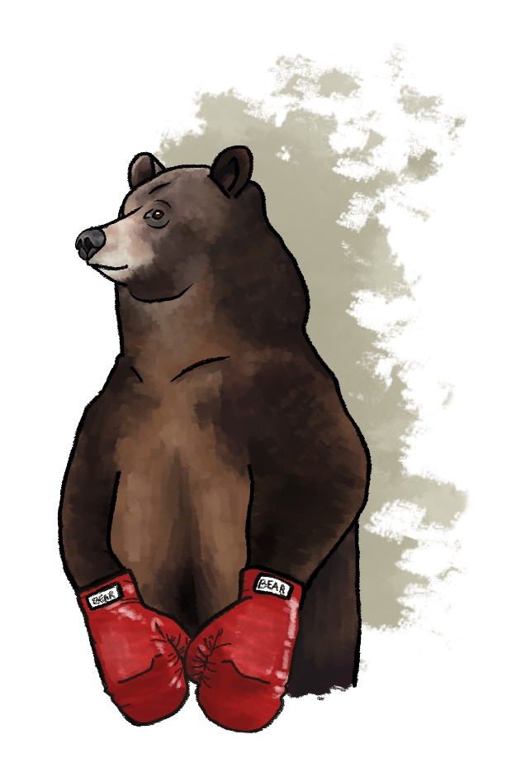
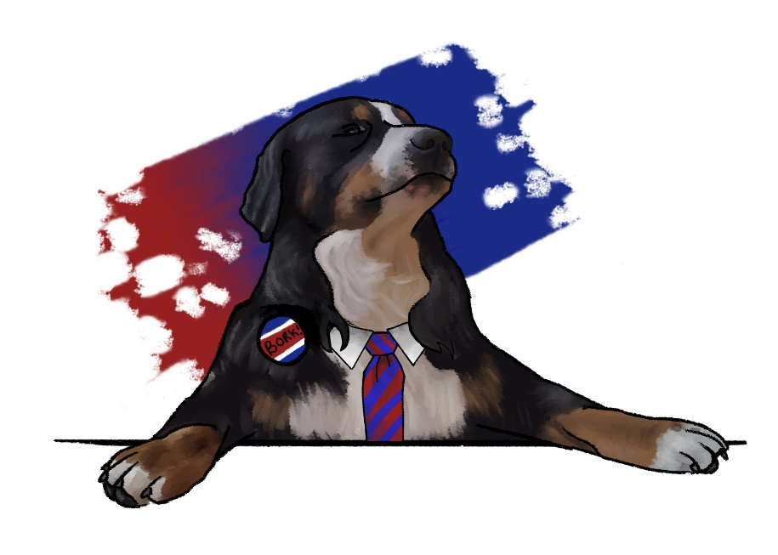
Animal
Holiday
Cards

Slide 10
