Slide 1
THE END IS NEAR!
Joshua Drouillard
Notes:
Hello my name is Joshua Drouillard and today I’m presenting my BFA Project titled: THE END IS NEAR!

Slide 2
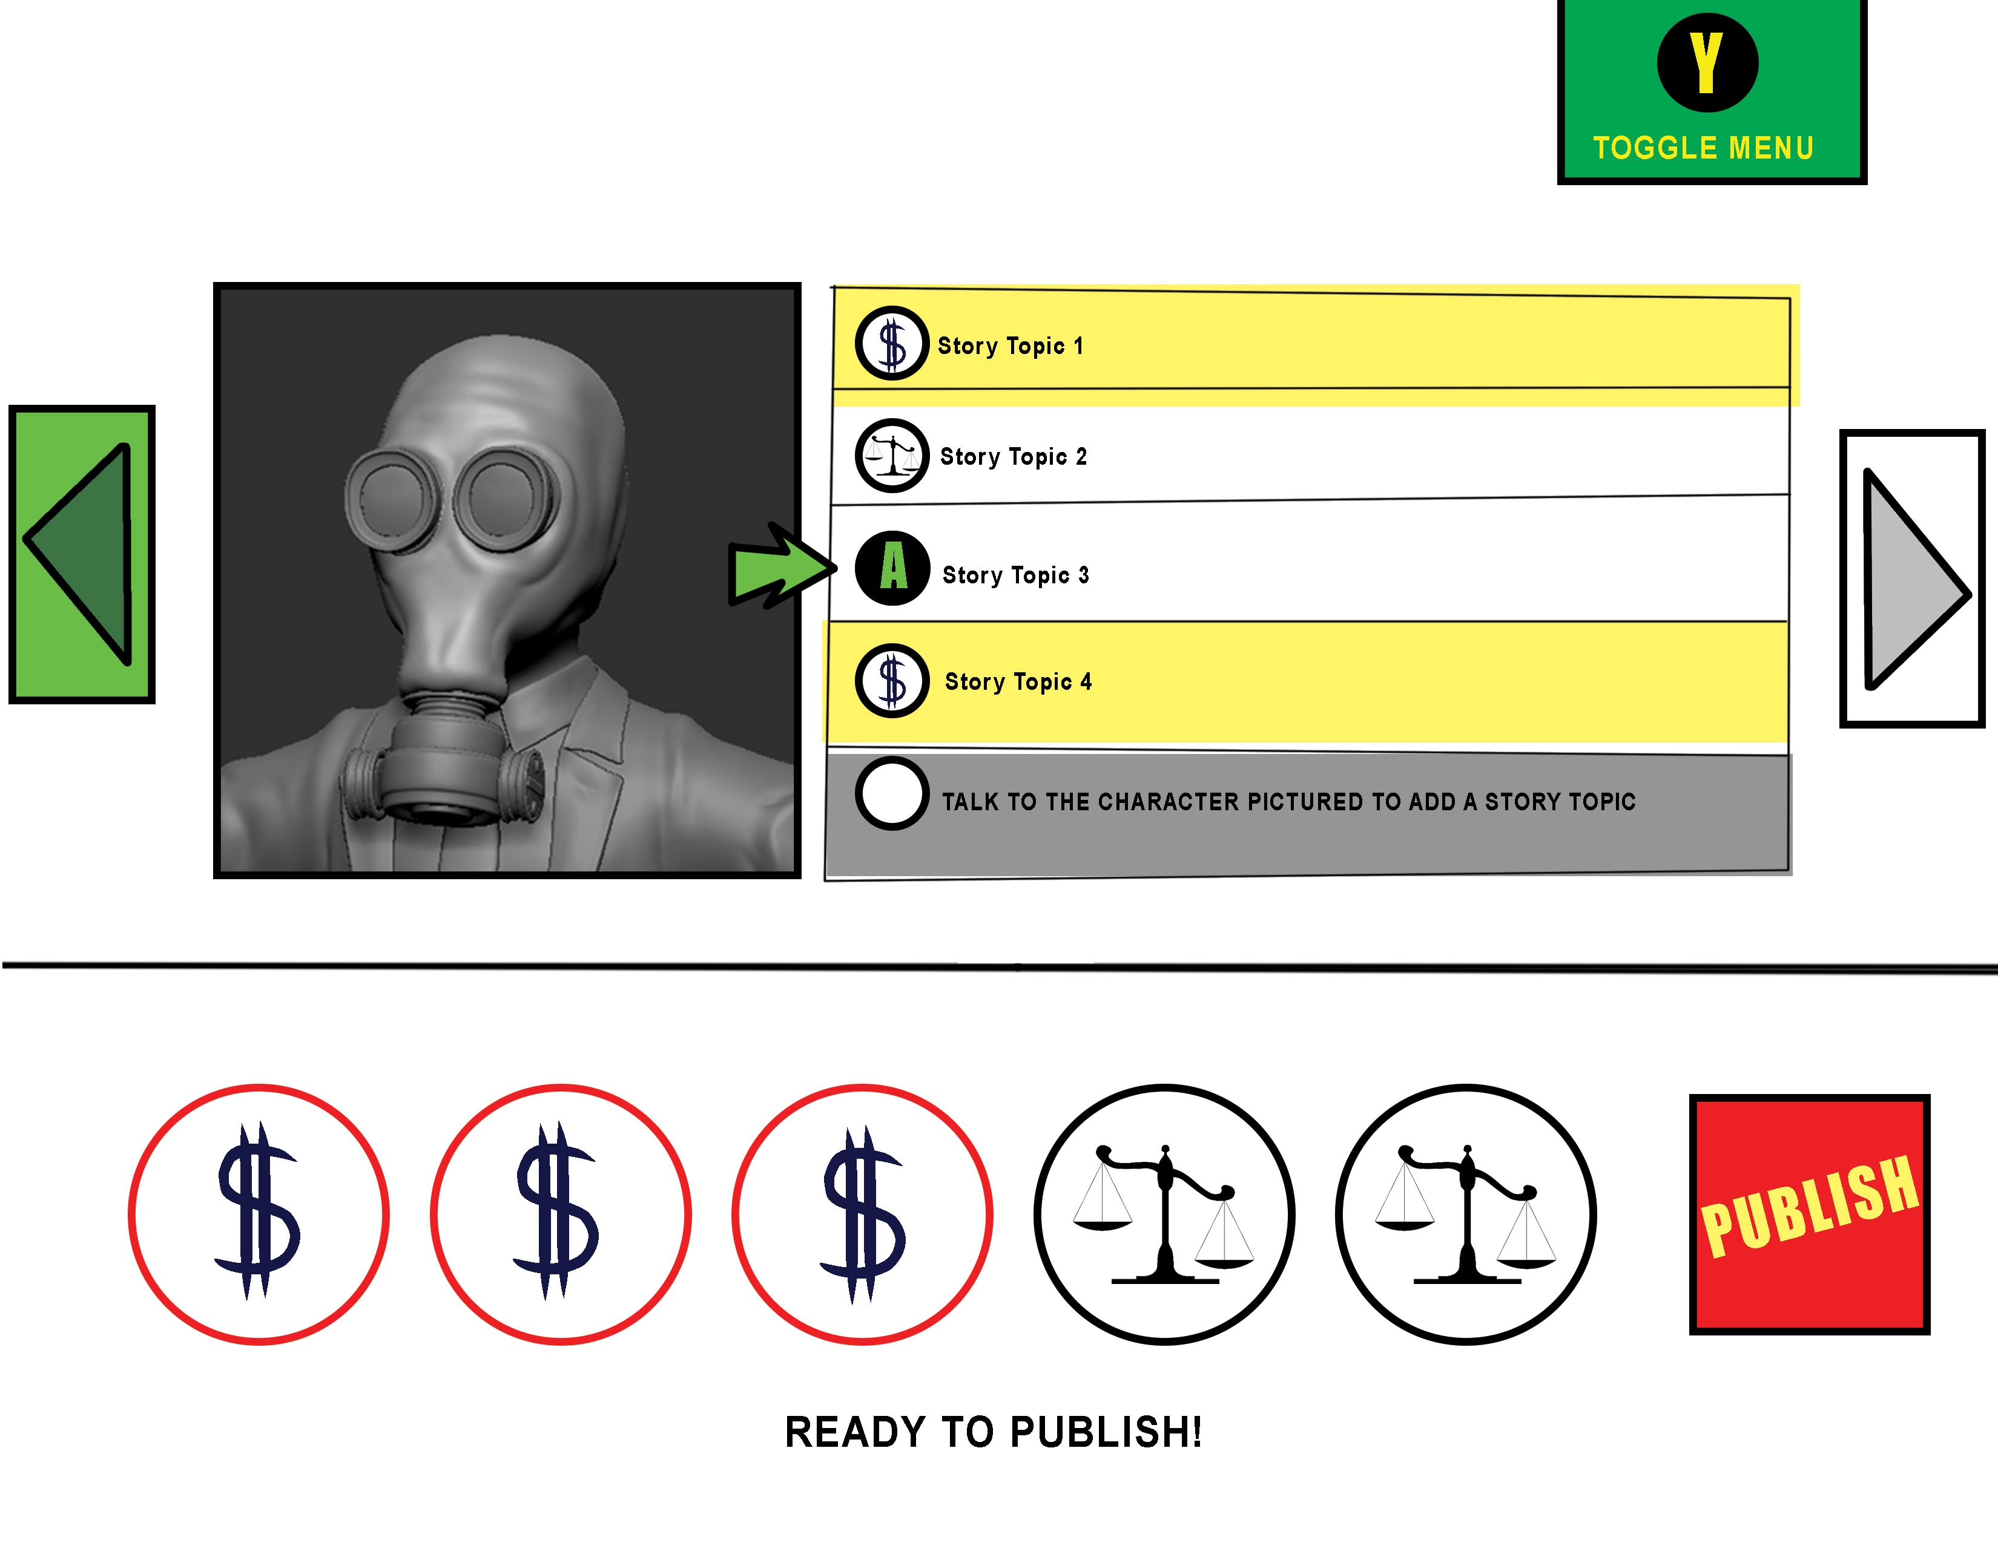
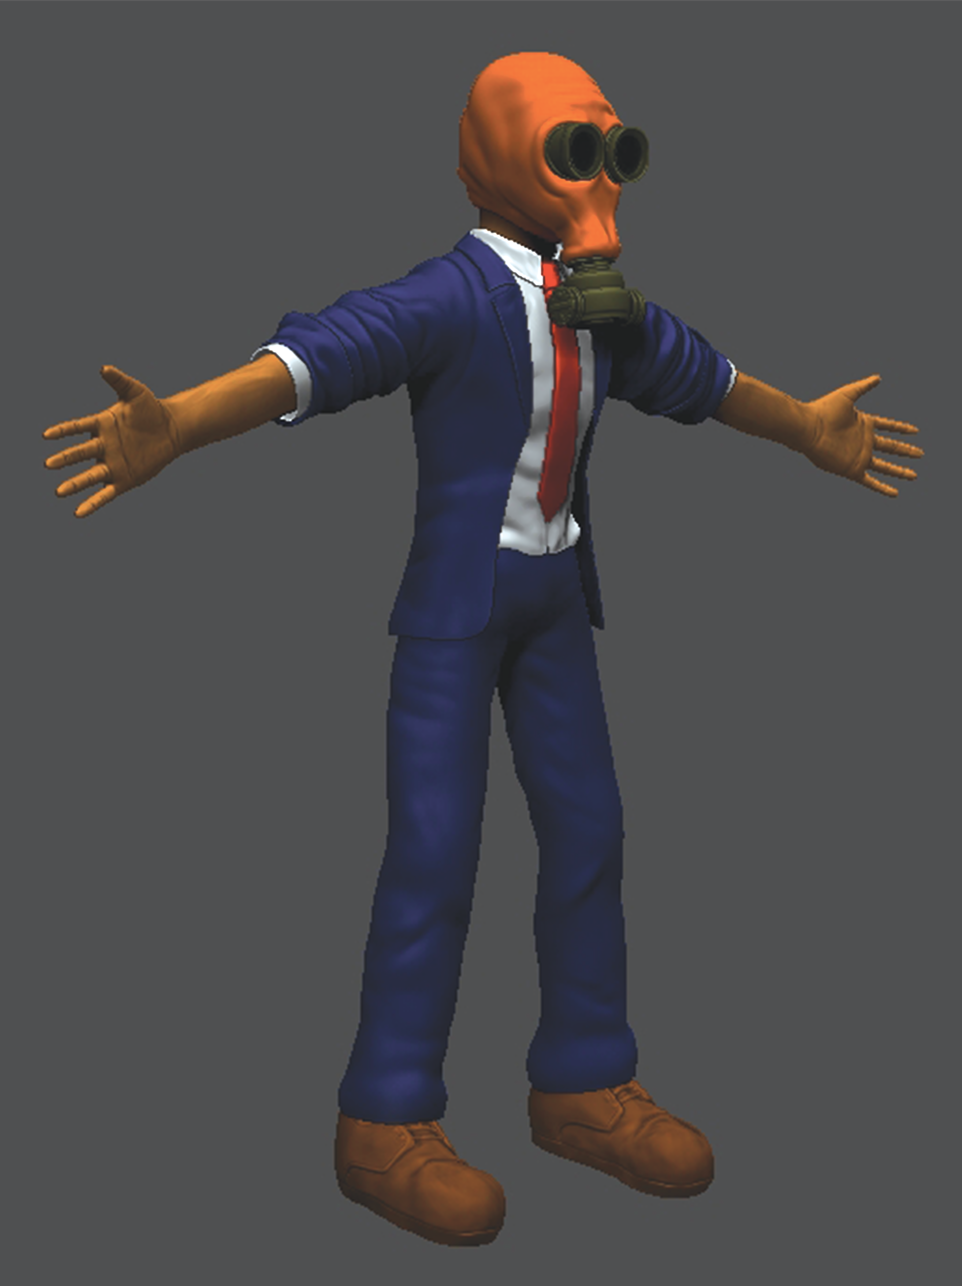
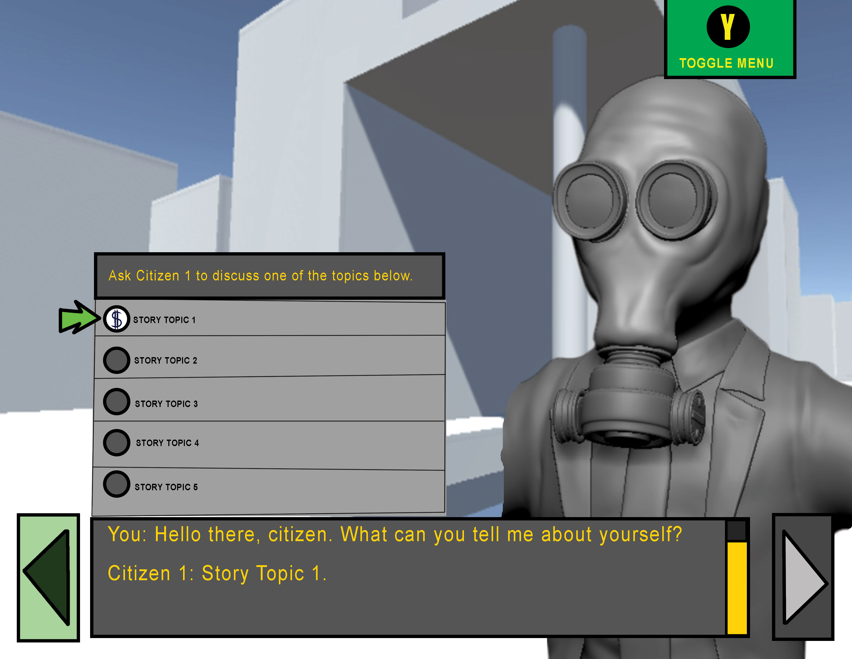
What is it?
Notes:
THE END IS NEAR is an interactive piece that deals with the responsibility of news outlets to report honestly and avoid “Fake News,” while tackling some of the outcomes that can come from reporting honestly vs. just reporting on fluff pieces to make money off of consumers.
I think in our current political climate it’s important to stay informed on issues, however it’s hard to know what news is real and what news is fake. This is why I wanted to make a piece speaking to reporters directly on the consequences of their actions for what they choose to report.

Slide 3
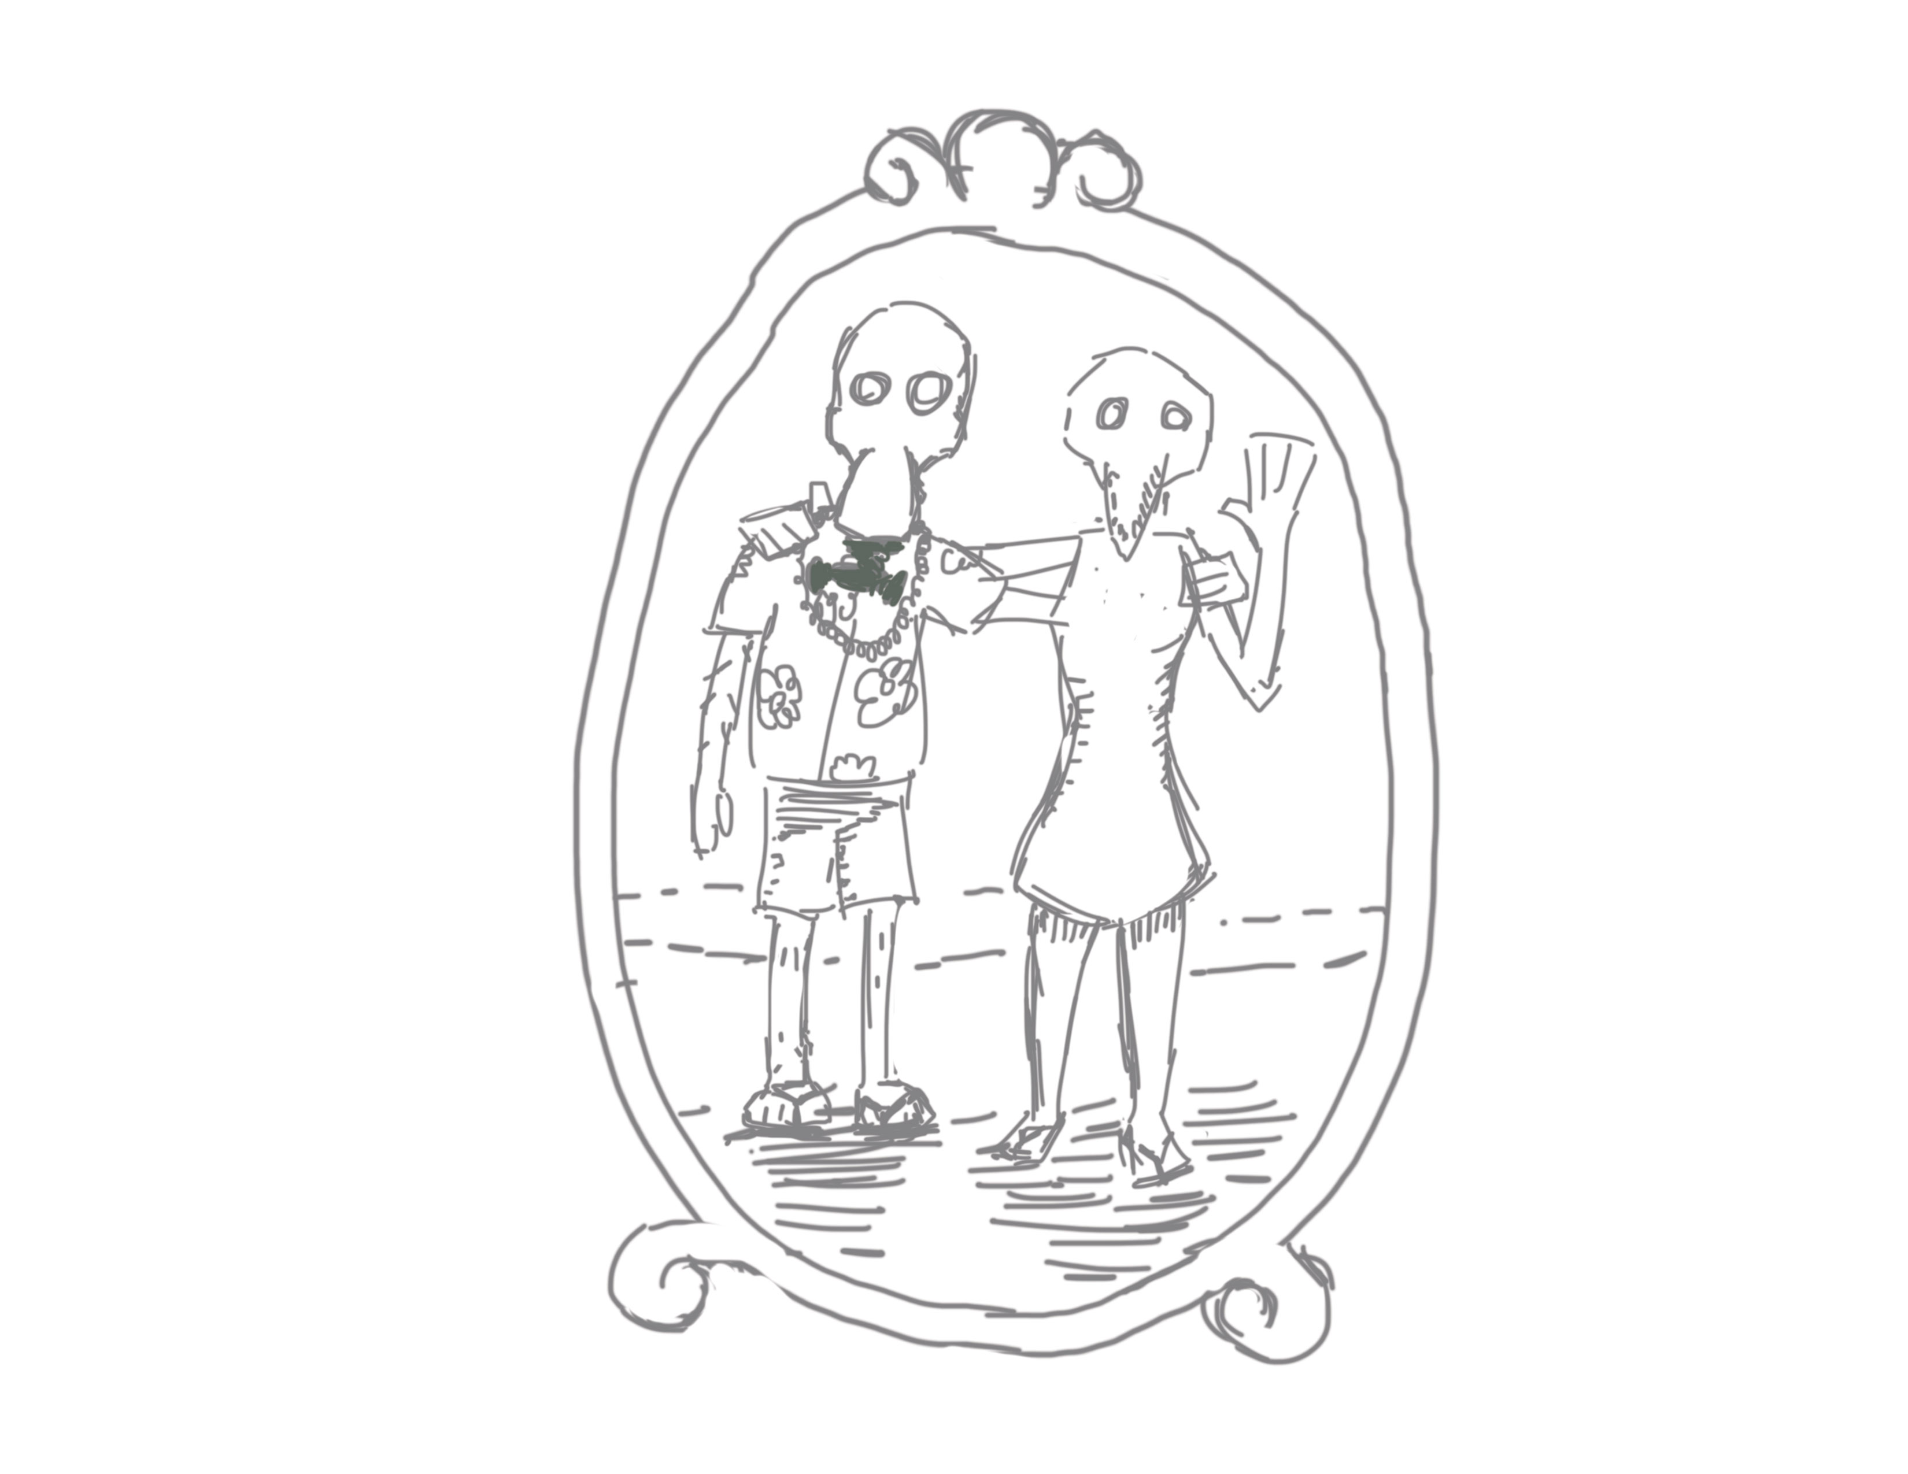
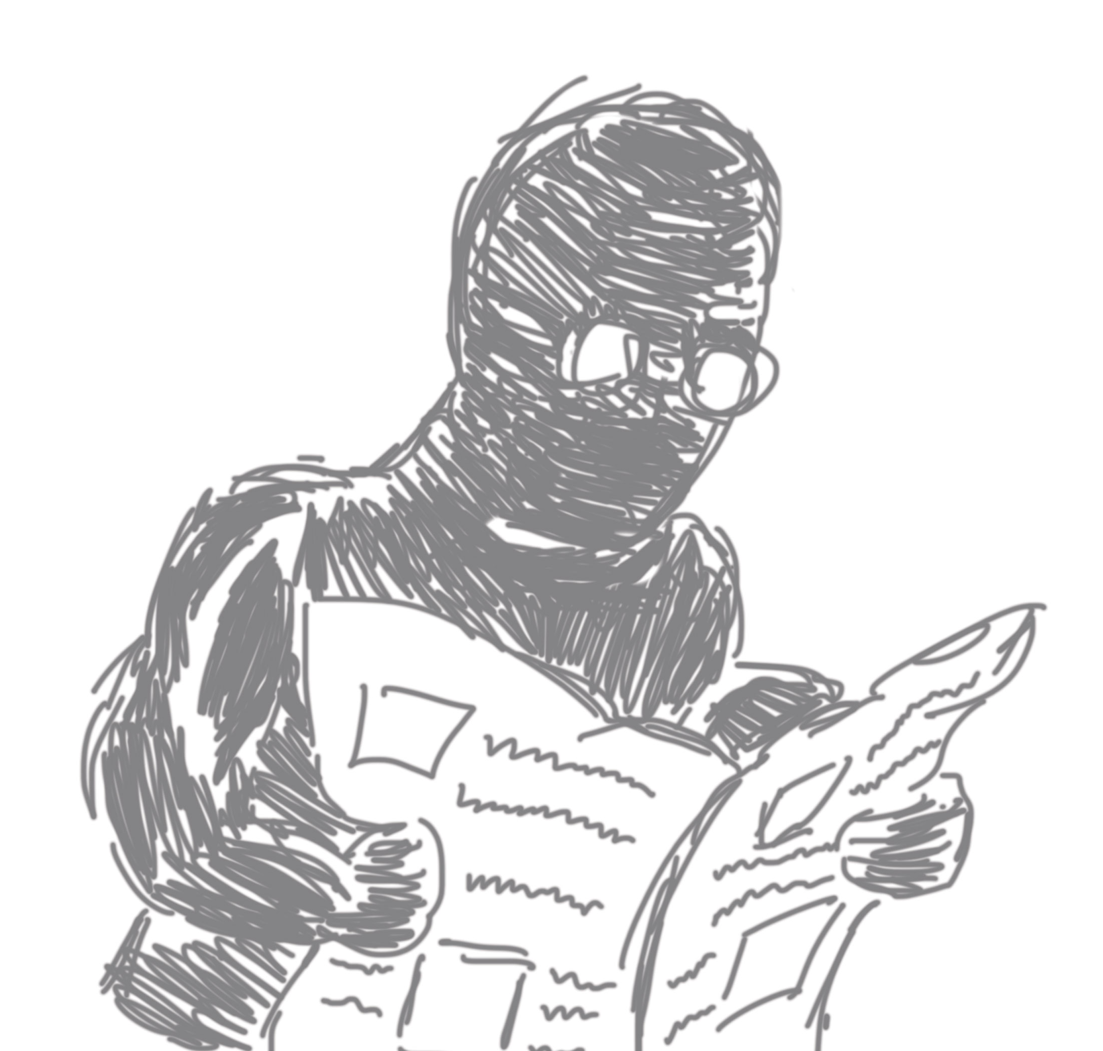
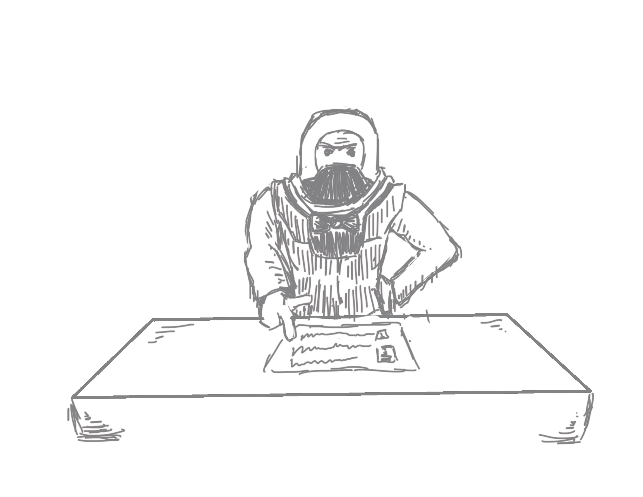
3 Story Factors
2) Family
3) Readers
1) Career
Notes:
The interactive experience contains three story pillars that provide exposition on the world. These will be communicated with illustrations with expositional dialogue that play before the experience. These same three story pillars are affected by the choices you make throughout the experience.
Story wise, you are a reporter in a semi-post apocalyptic world, working for a news outlet that wishes for you to interview citizens and report on meaningless, yet entertaining issues that make the paper sell. You as the reporter have the choice to follow these instructions or report on issues that are honest and educational for readers. There are thus two story endings that encompass the three story factors depending on what you choose.

Slide 4
Notes:
After you are introduced to the scenario with the expositional cutscene you are brought into this interface, which represents the organizational structure of the reporter’s mind. The text and layout will resemble news print to further this representation.
You can toggle this menu on and off by pressing Y.

Slide 5
Notes:
As you select topics to discuss with citizens, the topic is then added as an option to report on. There will always be an icon that clearly indicates if that topic is “Fake News” or “Real News.”
You can move between two different characters within the interface. While there is a fully modeled 3D environment present, you can not move within it freely. Rather, the camera will pan through the environment as you switch between the characters.

Slide 6
Notes:
Here you can see Topic 1 is now available to add as a publishable story as you have just conversed with the citizen about it.

Slide 7
Notes:
This is how it looks when a topic is added.

Slide 8
Notes:
You can add and remove topics at your leisure.
You need five stories selected in order to publish.
Once five are selected, you have the ability to publish.

Slide 9
3 Story Factors Ending
$
*
Notes:
Depending on which icon is represented most, you will get one of two endings. Endings will be illustrations with expositional dialogue pertaining to the three story pillars, similar to the intro.

Slide 10
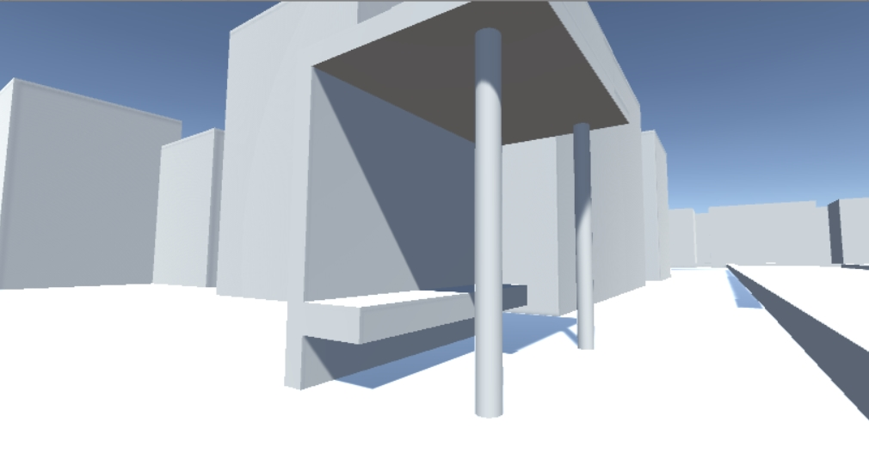
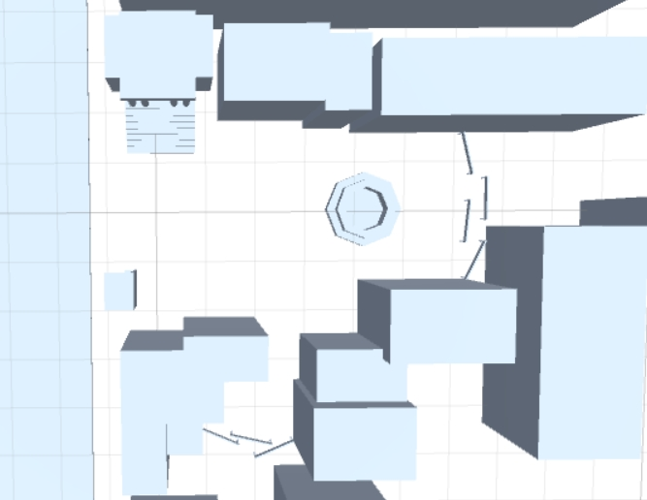
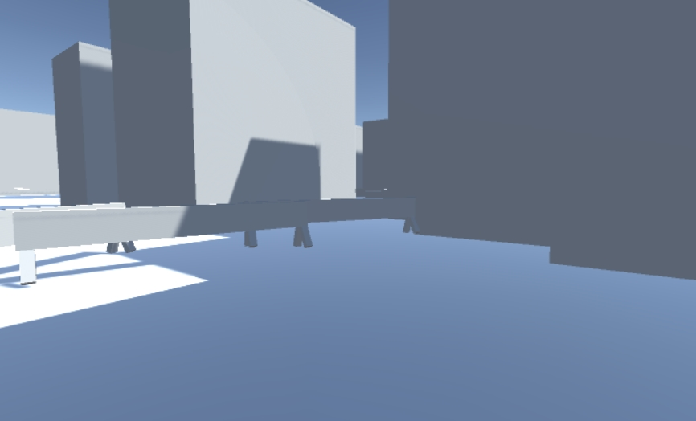
Environment Block In
Char 1.
Char 2.
Notes:
Here is my blocked in environment and where the characters will reside within them.

Slide 11
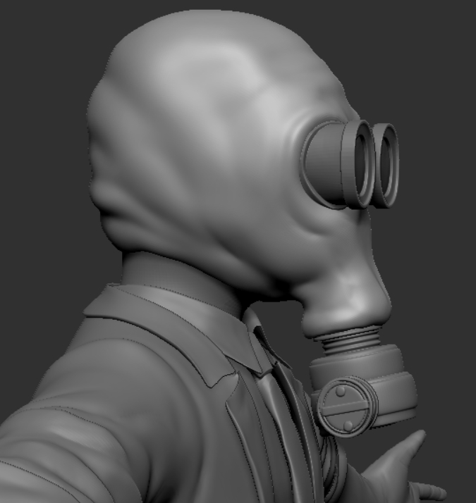
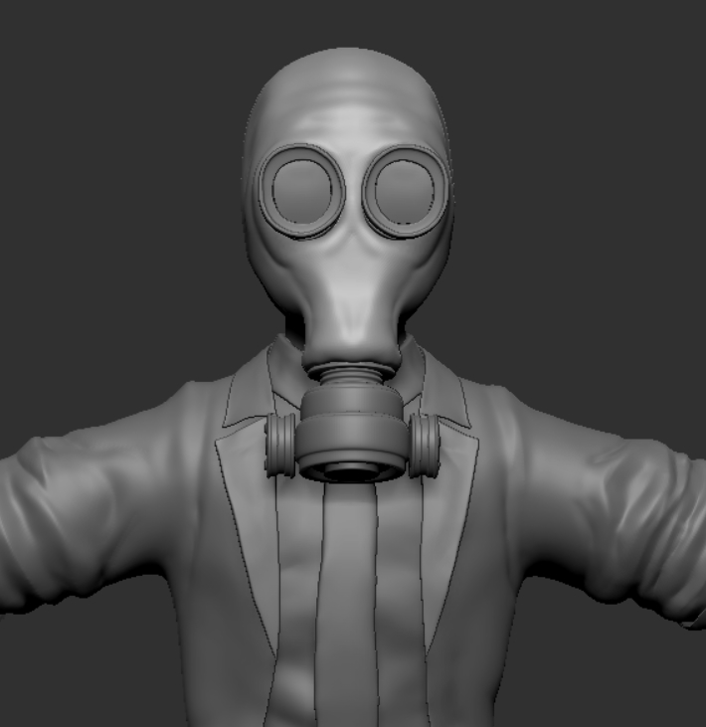
Character 1
Notes:
This is my progress with character one. His sculpt is finished. I am currently working on retopology. The colors are not final, just representational as one option.

Slide 12
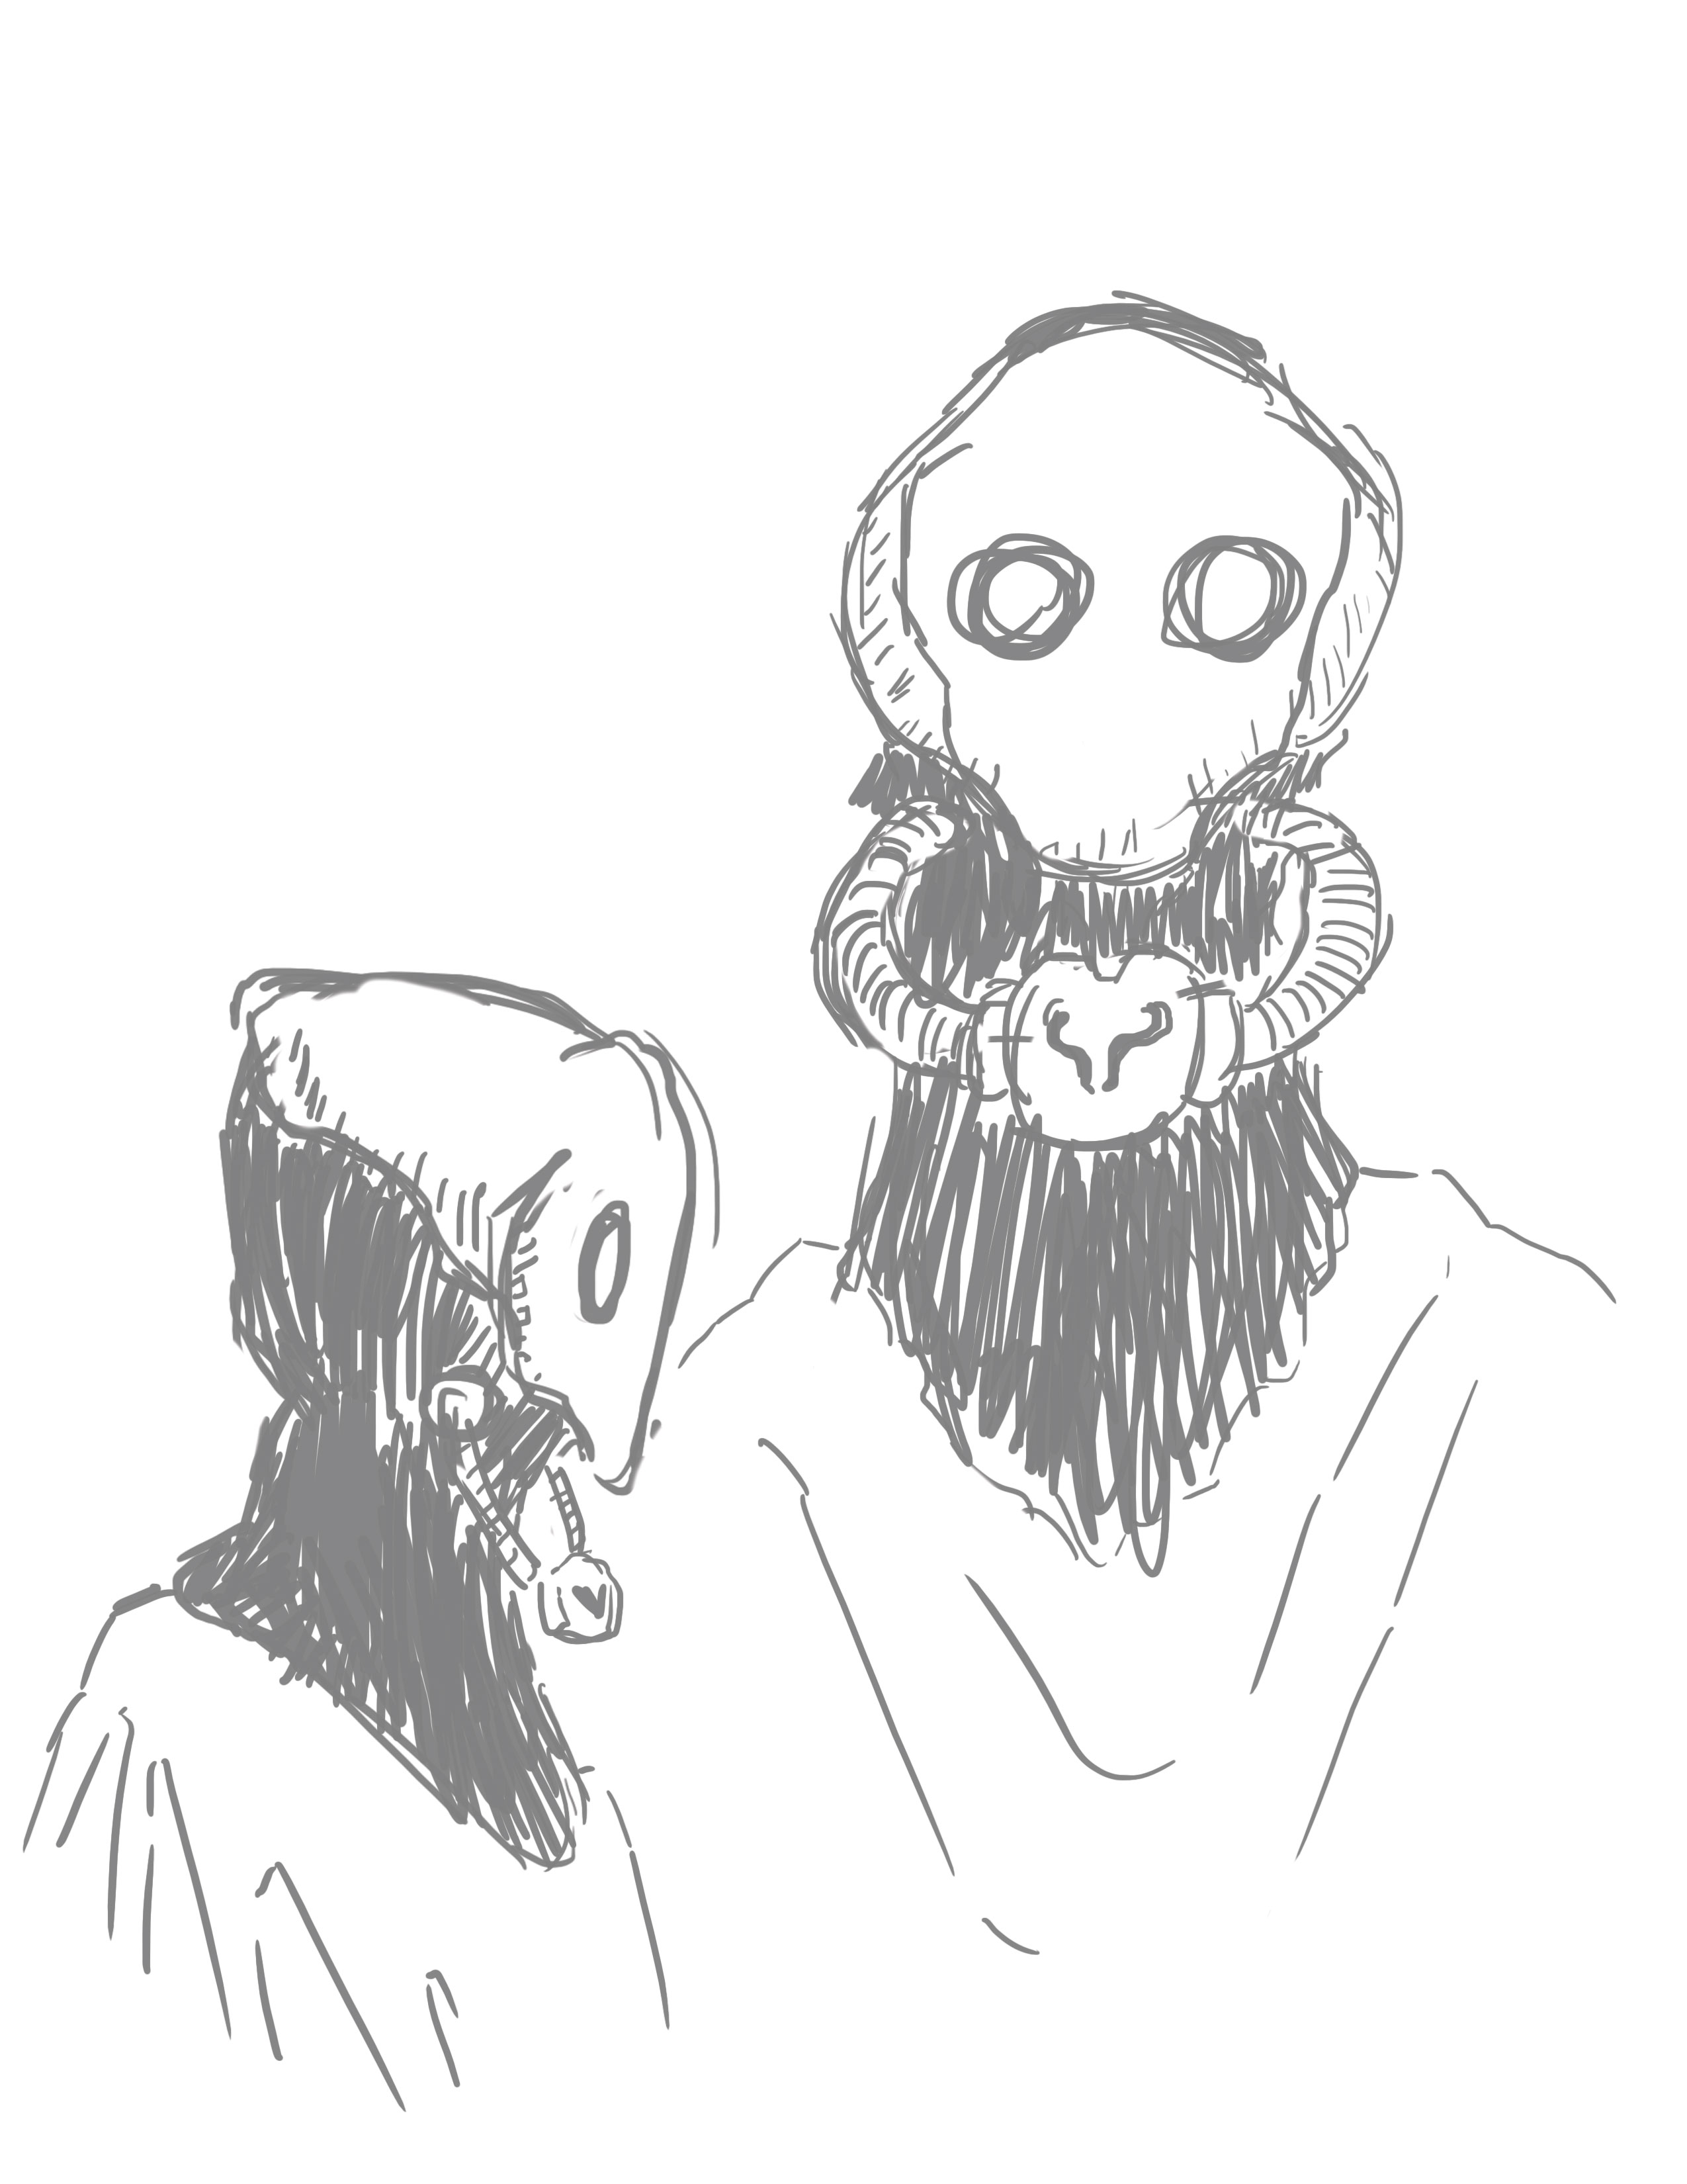
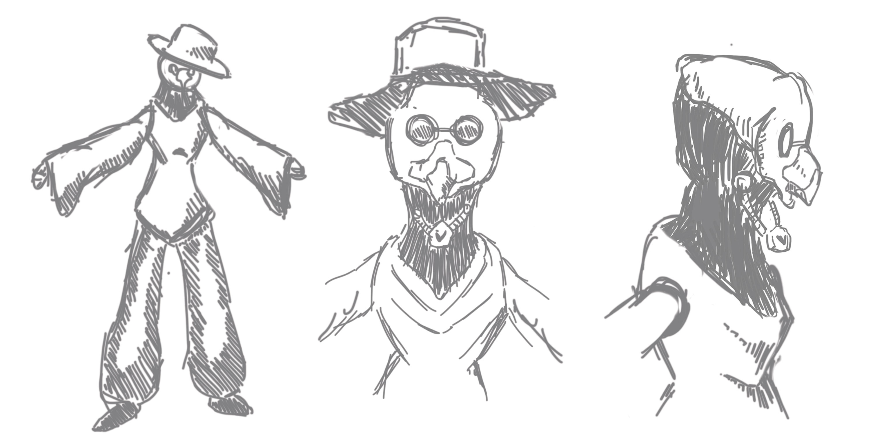
Character 2
Notes:
These are some concept sketches for character 2. While character 1 is meant to be more of a business minded male intern, character 2 will be a female who is more urban and free-spirited.

Slide 13
Calendar
Original
Updated
Environment Block In/Basic Interactivity
Character 1
Character 2
Character 3
Character 4
Finalize Environment
Environment Block In
Character 1
Sculpt
Retop
Texture
Animate
Basic Interactivity
Character 2
Illustrations for Exposition/Endings
Finalize Environment
Notes:
I’ve adapted my calendar according to my progress. The main change is I am making less characters but the interactivity is more complex that originally anticipated.

Slide 14
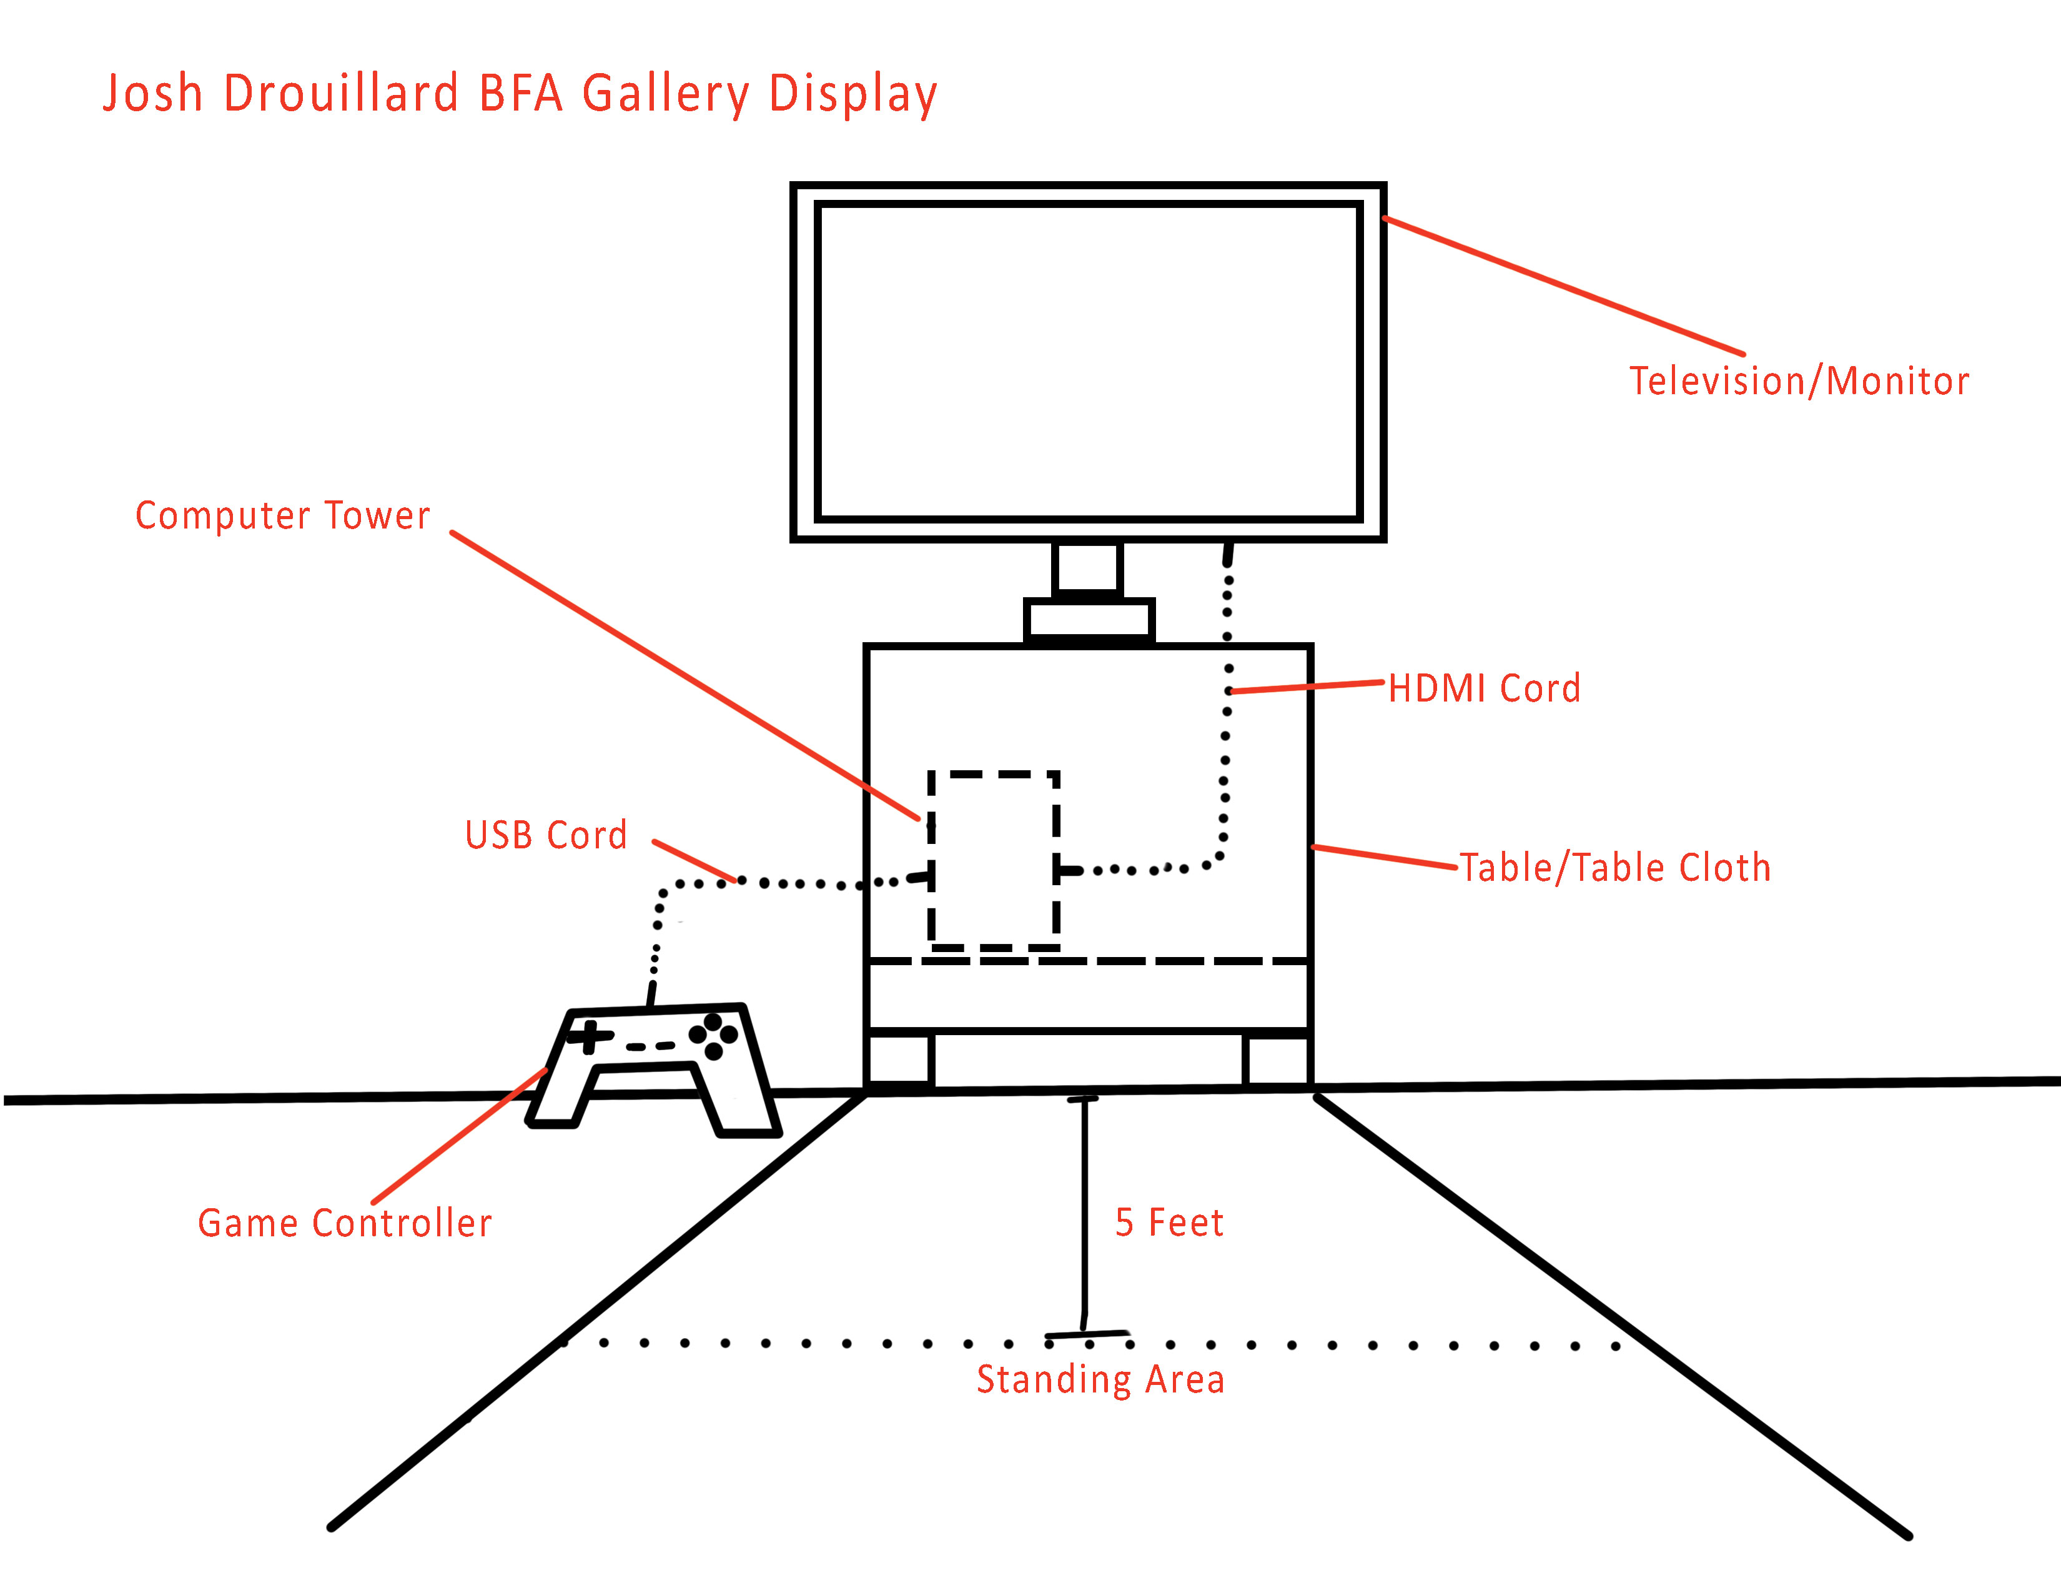
Gallery Set Up
Notes:
This is the planned layout for the gallery set up. I am also considering having a second screen set up that details instructions on how to perform given tasks with the experience.

Slide 15
THANK YOU!
FEEDBACK?

