Slide 1
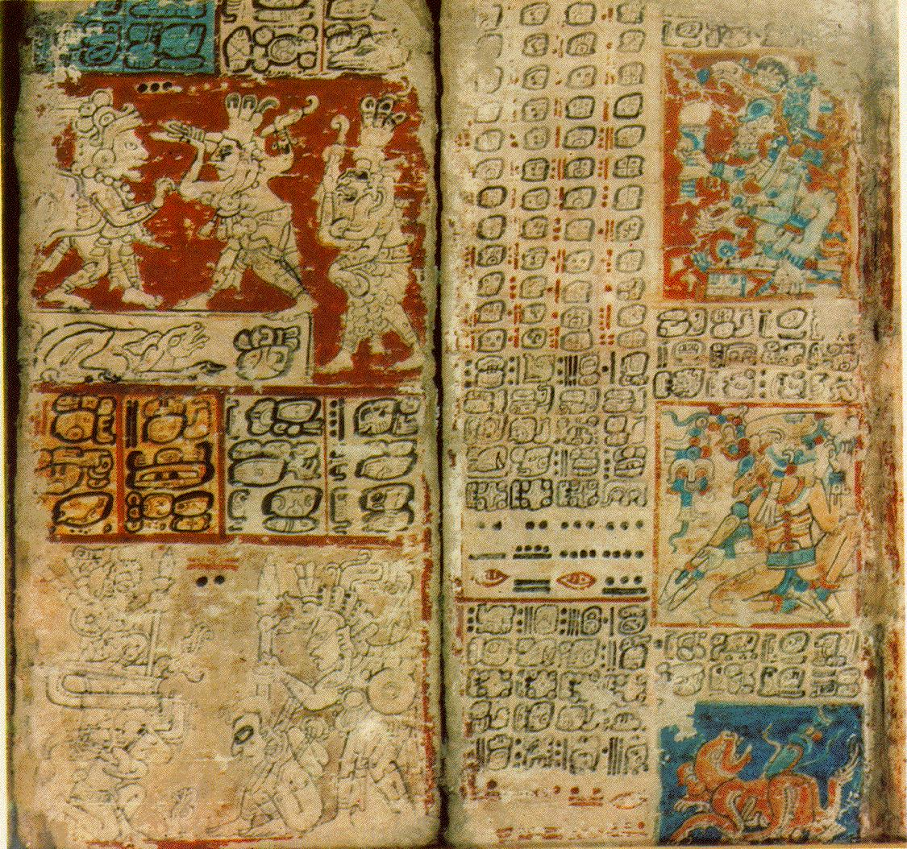
Maya Sequential Art

Slide 2
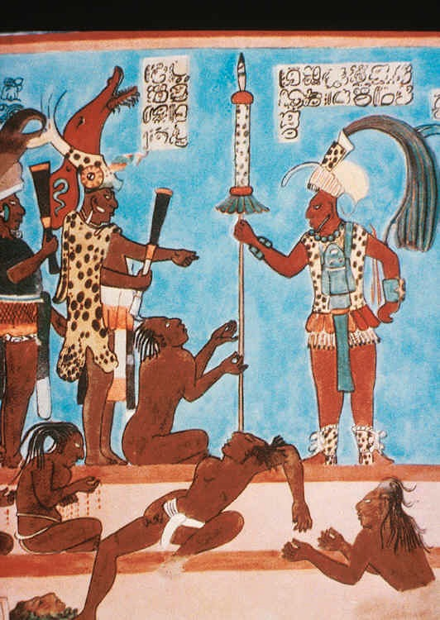
Maya Law Code The Maya seemed to have imposed harsh and immediate penalties on those who committed crimes. Adultery and murder were considered especially heinous.

Slide 3
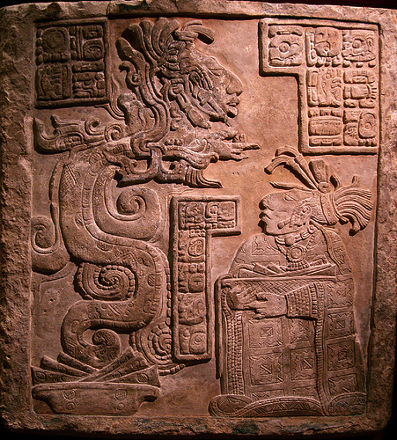
Maya mythology describes serpents as being the vehicles by which celestial bodies, such as the sun and stars cross the heavens. The shedding of their skin made them a symbol of rebirth and renewal. Thus the Vision Serpent could intercommunicate and speak to the gods on behalf of someone who is requesting to know a piece of the future.

Slide 4
"Dresden Codex” desde 1739 réplica códice Maya

Slide 5
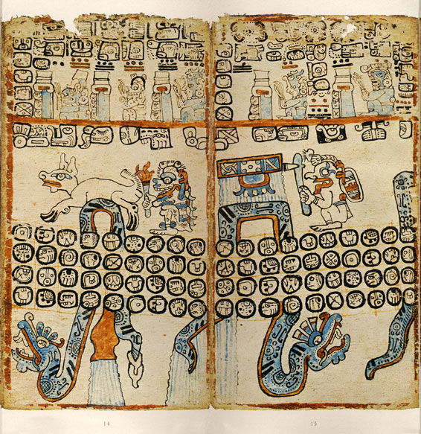
Códices Aztec codices (singular codex) are books written by pre-Columbian and colonial-era Aztecs. These codices provide some of the best primary sources for Aztec culture.

Slide 6
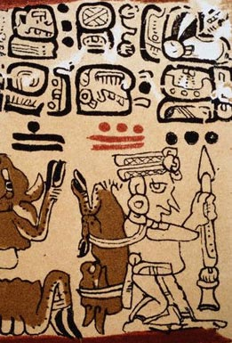
Madrid Codex In this detail from an almanac contained in the Madrid Codex, a hunter returns home with his kill.

Slide 7
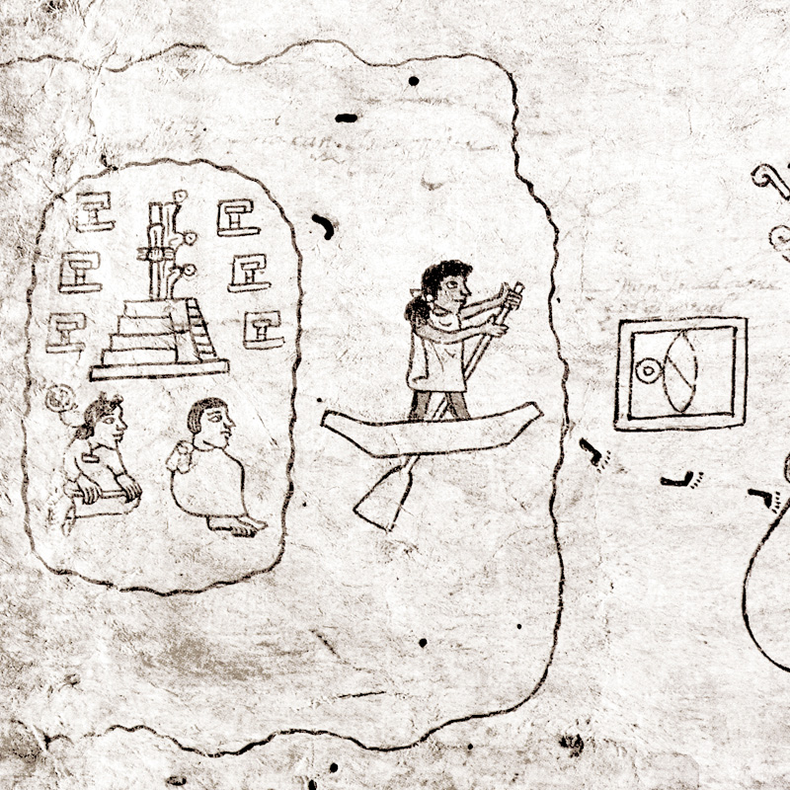
Detail of first page from the Boturini Codex, depicting the departure from Aztlán.

