Slide 1
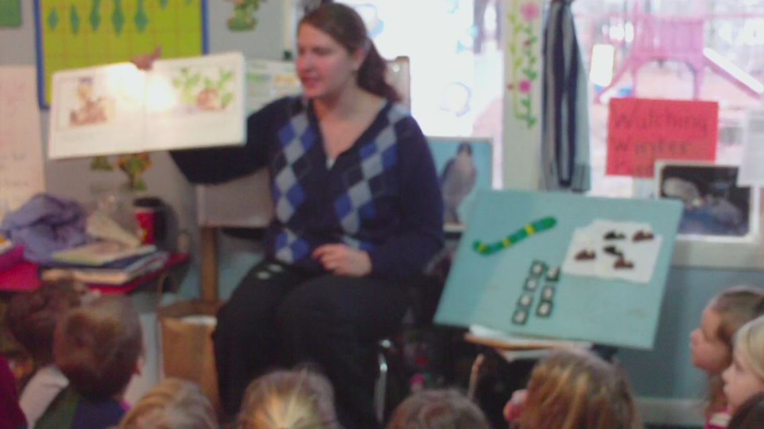
Best Practices: Lesson Study Project
Becca Ellerbrock
Notes:
-Hello. My name is Becca Ellerbrock and this is my lesson study project.

Slide 2
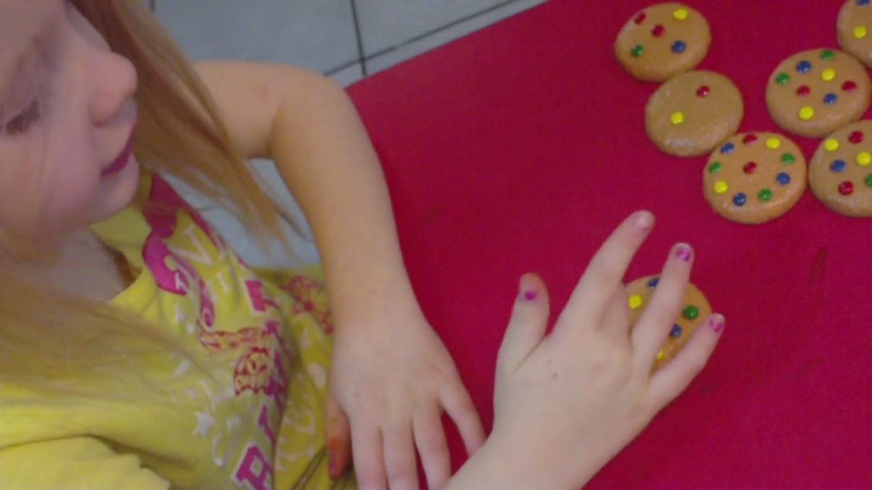
Setting
Around the Clock, Inc.
Findlay, Ohio
Preschool classroom
3-5 year olds
12-19 students daily
Diverse backgrounds
Notes:
-My lesson study project took place at Around the Clock, Inc., which is a preschool/daycare in Findlay, Ohio. I focused my study in the preschool classroom with children ranging from 3-5 years old. I had roughly 12-19 students in my classroom daily. Anyone who knows preschool classrooms knows that that is a lot of children. The state regulations for a typical preschool classroom is 12 students. This classroom has 2 teachers typically though which is why they can have more than 12 students. This is a diverse group of students that come from a wide range of backgrounds.

Slide 3
Difficult/Hard Topic
Early Learning Content Standards
Mathematics: Number, Number Sense, and Operations
2. Touch objects and say the number names when counting in the context of daily activities and play.
3. Demonstrate one-to-one correspondence when counting objects.
6. Compare sets of equal, more, and fewer, and use the language of comparison.
10. Identify and name numerals 0-9.
Ohio Department of Education website: www.ode.state.oh.us/
Notes:
-The topic I those to focus on in this preschool classroom were numeracy skills in mathematics. The standards you see above are taken directly from the Early Learning Content Standards, which are preschool learning standards found on the Ohio Department of Education website. I chose to focus my study on touch counting, mathematical language, and number recognition.

Slide 4
Research on Difficult/Hard Topic
“Although preschool children have developed a surprising ability to learn conventional numbers, many of them still have problems in learning it” (Zhou & Wang, 2004, p. 255).
“Fewer and fewer students understand and enjoy math” (Zemelman, Daniels, & Hyde, 2005, 106).
Children begin learning math with simple recitations of nursery rhymes but it is difficult for them to move to the abstract of knowing what those numbers actually mean (Klibanoff, Levine, Huttenlocher, Vasilyeva, & Hedges, 2006).
“Sometimes one symbol or one simple mathematical formula presents many complicated meanings. Therefore the learning of the symbol system has posed a great challenge for new learners” (Zhou & Wang, 2004, p. 253).
Notes:
-I have had a lot of experience in preschool classrooms. In fact, I used to work at this daycare/preschool. I know that these numeracy skills are difficult to teach and hard to learn. Through the research I did on this topic, I found many articles to support my personal knowledge. Some examples are recorded above from both research articles and the textbook for this class.

Slide 5
Research on How to Best Teach
“Active learning, critical questioning, and the construction of meaning” (Greene, 2000, p. 272).
Preschool teachers should be using “math talk” in daily activities with children (Klibanoff et al., 2006).
Let students use invented number symbols in writing and speaking (Zhou & Wang, 2004).
Play matching and sorting games. Pair number words with amount of objects. Encourage children to use 1-1 correspondence. Teach strategies for keeping track of counted items. Ask questions that prompt counting. Count in typical play settings (Sadler, 2009).
Provide props and manipulatives. Make connections to daily lives. Use real world experiences (Zemelman, Daniels, & Hyde, 2005).
Notes:
-Because I have had so much experience in this type of classroom, I already had some ideas of how I wanted to teach this topic. However, I did further research to determine best practice methods of teaching. I then combined the ideas above with my own ideas to plan specific lessons for numeracy skills in preschool classrooms.

Slide 6
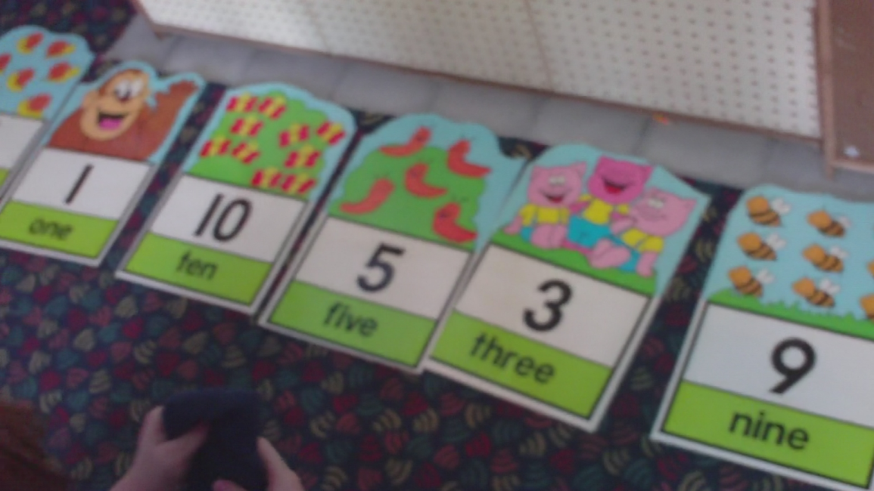
Pre-Assessment
“Assessment should help teachers better understand what students know and make meaningful decisions about teaching and learning activities” (Zemelman, Daniels, & Hyde, 2005, 106).
Individual sessions with students for 3-5 minutes
Use of manipulatives
Set question prompts
Notes:
-To pre-assess my students for this lesson study, I held individual sessions with each student. The students were engaged in center time, which means that the students were rotating through multiple centers set up around the classroom. I would call a student over, one at a time, to come “play math” with me. The students came to sit with me at a table away from everyone else. I had blocks and printed numbers sitting on the table. I had a set of question prompts that I walked through with each student. For example, I had them split blocks into two equal groups, identify the numbers, touch-count the blocks, etc.

Slide 7
Pre-Assessment Results
Name | # Recognition | 1-1 Correspondence | Vocabulary
Jayla | None | No | No
Miguel | None | No | No
Santiago | Less than ½ | Yes | No
Logan | More than ½ | Yes | No
Rasheed | None | Yes | No
Tiyanna | None | No | No
Chloe R. | Less than ½ | No | No
Aubree | More than ½ | No | No
Dd | Less than ½ | No | No
Chloe W. | None | No | No
Reflects only students who were present for both the pre-test and post-test.
Notes:
-These are the results from the pre-test I conducted with the students. The table above reflects only students who were present for both the pre-test and the post-test. I would like to point out that no one knew the vocabulary words when related to math (equal, fewer, more, etc.) very few students could touch count, and no students could recognize all numbers 0-10.

Slide 8
Day One: Lesson
Read Mouse Count with felt board pieces
Paper bag Numbers Center Activity
Counting Cookies Center Activity
Number Hop Center Activity
Notes:
-For my first lesson with the students, I completed a whole group activity and three center activities. The whole group activity consisted of me reading a book aloud to the students. Each student had a felt piece that went along with the story which was put on a felt board for the whole class to see. We counted mice as they went into a jar and as they came back out. We also had felt numbers to match each number in the book. The first center was Paper bag numbers. For this activity, the students received an empty paper bag with a single number written on the outside. The students were to go around the classroom and find as many items as the number on their bag. They then brought their bag to me and we “checked” their work. This actually turned out to be their favorite activity which was a surprise to me. The second center was Counting Cookies. For this activity, 3-4 students at a time would sit at the housekeeping table. They pulled cookies out of a jar, counted the number of chocolate chips on the front of the cookie, then flipped the cookies over to check to see if they counted correctly (there was a number on the back of the cookie). For the last center, the students hopped around the classroom saying a number that they hopped on. I had large numbers spaced around the floor. For example, the students hopped on number 4, said number 4 then hopped to another number, said that number, etc. All students participated in the full group activity. Most of the students participated in the centers but it was their choice if they wanted to.

Slide 9
Day One: Best Practices
Collaboration between students
Collaboration between teacher and students
Active teaching, hands-on
Multiple methods of instruction
Communication between students
Communication between teacher and students
Challenging and developmentally appropriate content
Student centered lessons
Real world examples
Notes:
-This is a listing of best practices from the textbook that fit into the lesson and centers I used for lesson 1.

Slide 10
Day Two: Lesson
Tracing/Writing Number Center Activity
Bean Bag Toss Center Activity
Counting Cookies Center Activity
Was not able to do full lesson
Notes:
-My second lesson actually happened to fall on St. Patty’s Day. This caused me to not be able to do my full lesson because the regular classroom teachers already had a lot planned. I worked around them though and was still able to set up a few centers. I worked in the centers with the students. The first center consisted of students tracing numbers and then writing the numbers by themselves below. This was very hard for my students because most of them do not have the necessary fine motor skills for this. The next center used large numbers placed on the floor in a random order. A few students at a time came over and picked up a beanbag. The children and I took turns calling out numbers. They had to find that number and throw their beanbag on it. The last center was the counting cookies center again that took place in lesson 1. Again, it is was students’ choice to participate in my centers but most of them did.

Slide 11
Day Two: Best Practices
Collaboration between students
Collaboration between teacher and students
Students and teacher share multiple roles
Active teaching, hands-on
Multiple methods of instruction
Communication between teacher and students
Challenging and developmentally appropriate content
Student centered lessons
Students engaged in metacognition
Notes:
-Here is a list of best practices from the book that took place during lesson 2.

Slide 12
Day Three: Lesson
Work individually with students in authentic play setting
Felt Numbers/Number Sticks Matching Center Activity
Was not able to do full lesson
Notes:
-My third and final lesson was also not able to go as I had originally planned it. When I arrived at the daycare/preschool, there were two people observing (one a state representative and one a STARS representative. These are people that come into the daycare 1-3 times per year to observe and make sure that everyone is following the rules. These are surprise visits, meaning no one knows when they will show up to observe. Both representatives from different companies just happened to pick this day to do their observations.) Therefore, I was not able to do my full lesson but I did set up one center and work individually with children in their typical play settings. The center used felt numbers, numbers on sticks, and a felt board. The students had to work together to put the numbers in order and then match the numbers (2 with 2, 3 with 3, etc.). In the authentic play settings, I sat with the students in a center of their choice and asked them questions like “I see you traced your hand, how many fingers do you have? If I traced my hand would I have an equal number of fingers, more, or less?” “I see you have built a boat over there using 7 blocks. How many blocks did I have to use to build my train? Is that more or less than you?” etc. This authentic play actually worked out to be one of the best ways for me to teach and for the students to learn.

Slide 13
Day Three: Best Practices
Collaboration between students
Collaboration between teacher and students
Active teaching, hands-on
Multiple methods of instruction
Communication between students
Communication between teacher and students
Challenging and developmentally appropriate content
Higher-order thinking skills
Student centered lessons
Authentic, experiential learning
Real world examples
Notes:
-Here is a list of best practices from the book that I used in lesson 3.

Slide 14
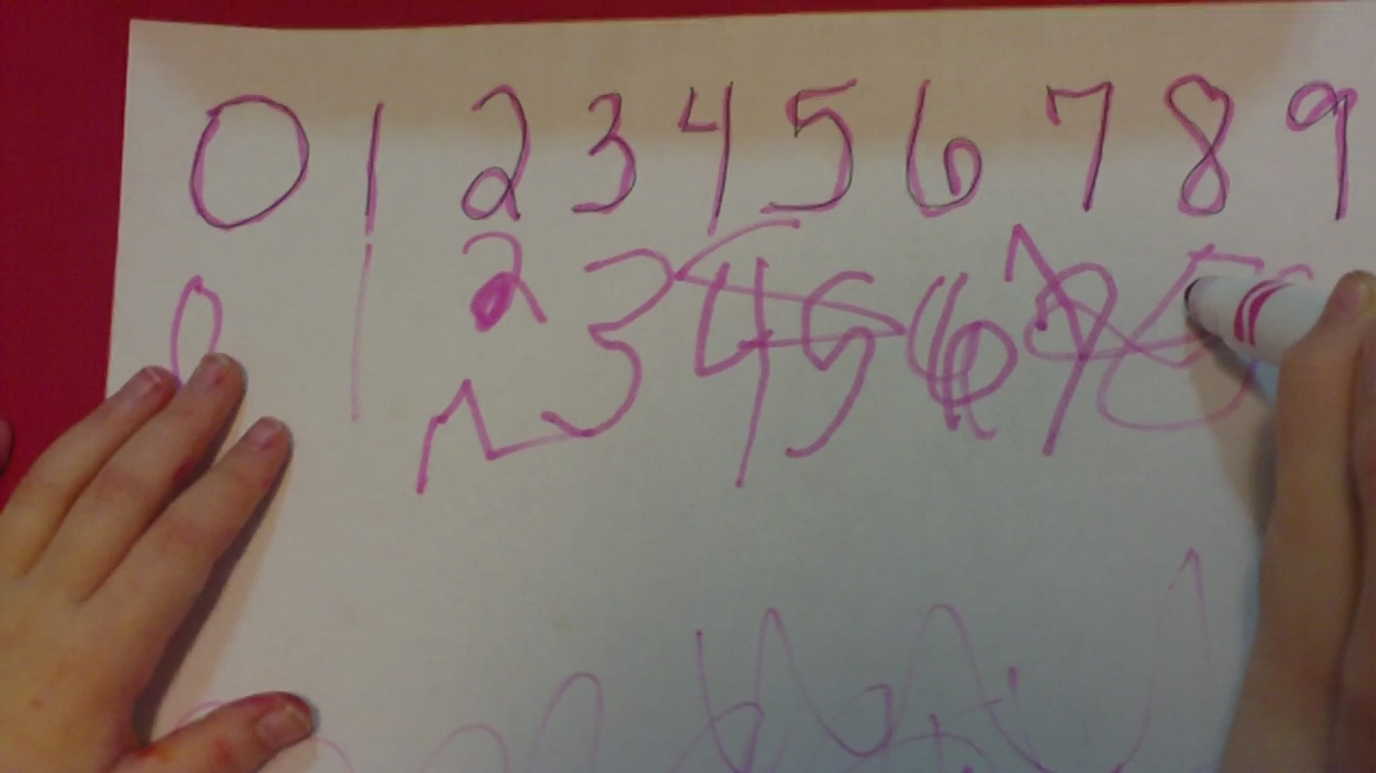
Post-Assessment
Individual sessions with students for 3-5 minutes
Use of manipulatives
Set question prompts
Notes:
-After three lessons in the daycare/preschool. I set up my post test. The post test was schedule for a full week after my last lesson was taught. The teachers that are typically in this classroom had already agreed in the beginning of this lesson study to not teach about numeracy skills until after I had taught and tested everyone, this way I could determine what I actually taught the students throughout my lessons. I sat down with the students individually and completed an assessment much like the pre-assessment. I used different numbers in my questions but it was essentially the same.

Slide 15
Post-Assessment
Name | # Recognition | 1-1 Correspondence | Vocabulary
 | Pre → Post | Pre → Post | Pre → Post
Jayla | None → Less than ½ | No → Up to #8 | No → Yes
Miguel | None → All but #10 | No → Yes | No → Yes
Santiago | Less than ½ → All | Yes → Yes | No → Yes
Logan | More than ½ → All | Yes → Yes | No → Some
Rasheed | None → More than ½ | Yes → Yes | No → Yes
Tiyanna | None → Only #3 | No → Up to #5 | No → Some
Chloe R. | Less than ½ → All | No → Yes | No → Some
Aubree | More than ½ → All | No → Up to #5 | No → Some
Dd | Less than ½ → More than ½ | No → Yes | No → No
Chloe W. | None → Less than ½ | No → Yes | No → Yes
Reflects only students who were present for both the pre-test and post-test.
Notes:
-This table shows the results from my post-assessment matched with my pre-assessment. The post assessment is listed second in pink while the pre-assessment is listed first in black. I would like to point out Miguel who was the only student to master every skill with 100% accuracy. Although it says he did not know #10, the standards that were listed on a previous slide list that preschool students only need to know 0-9. I just included 10 as well. I would also like to point out Tiyanna. Tiyanna is a 3 year old student that JUST moved up from the toddler room to the preschool room because she just turned 3 right before I started this lesson study. This is a completely new surrounding to her. Finally, I would like to point out Dd. Dd is a student who just moved to the United States from China a few months ago. He understands some English but only speaks a few English words so far.

Slide 16
Did they learn?
YES!!
Multiple formative assessments and the final post-assessment prove that the students did learn.
I also worked very closely with the students throughout centers and play times.
Did they master everything?
No.
Everyone did improve though, and I was able to introduce concepts that the students will be learning about all year.
Notes:
-So for my conclusion, did my students learn? Yes, I totally and completely believe that my students learned. I used multiple formative assessments and observations throughout my lessons and completed a post-test a full week after my last lesson. This way, I knew that my students didn’t just memorize the material, they learned it and were able to apply it.
-Did every student master each content standard? No, but every did learn and everyone improved from the pre-test to the post-test. I was able to introduce important concepts to them that they will not only continue learning for the next couple of years they are in preschool but also skills they will need for the rest of their lives.

Slide 17
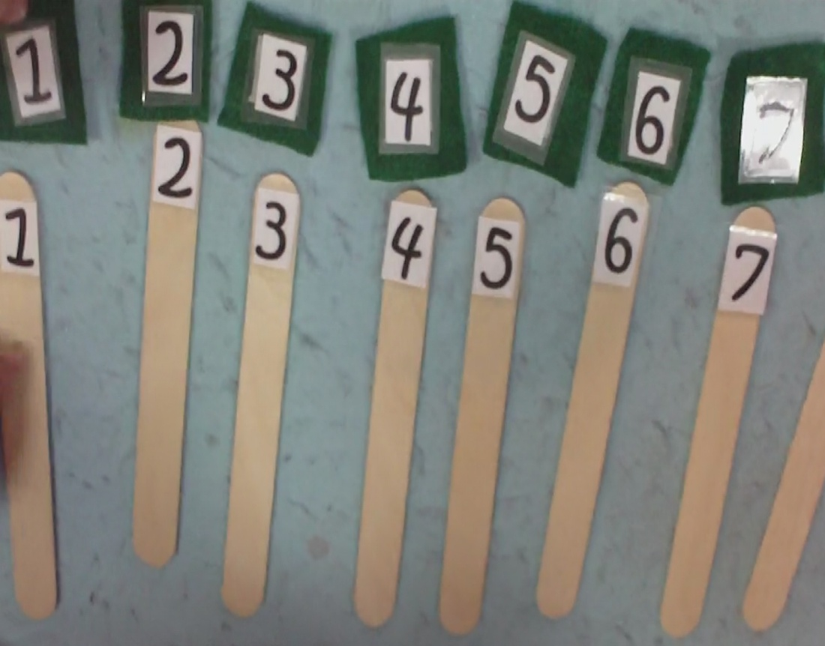
What would I change?
Schedule in more time
Plan around regular
classroom teacher
activities more
specifically/Find out
exactly what else was
occurring in the classroom
each day
Work with students
more often in their
typical play settings
Notes:
-After finishing my lesson study, reviewing the lessons and the pre and post assessments, and studying the research, I have figured out a few things that I would definitely change if I completed this lesson study again. For example, my lessons were only about 1 hour each one time per week for three weeks. I would either like to do two-one hour lesson per week for those three weeks or I would like to stay for two hours for each lesson for three weeks. Also, when I planned my schedule, I asked the teachers what were their least busy days. They told me Thursdays so I planned my lessons for those days. Next time I would find out exactly what they had planned on those Thursdays so I could better plan my lessons to fit in with their daily activities. Also, through experience and more research, I found that working with the students in their authentic play settings was one of the most valuable learning experiences. I would like to include more of this when/if I teach these lessons again. I am not saying that these will guarantee that all of my students will master the experiences the next time I teach it, but I do think these will improve my lessons and each time I teach this, I will get better.

Slide 18
References
Greene, M. (2000). Imagining futures: The public school
possibility. Curriculum Studies, 32(2), 267-280.
Klibanoff, R. S., Levine, S. C., Huttenlocher, J., Vasilyeva, M., &
Hedges, L. V. (2006). Preschool children's mathematical knowledge: The effect of teacher "math talk". Developmental Psychology, 42(1), 59-69.
Ohio Department of Education. www.ode.state.oh.us/
Sadler, F. H. (2009). Help! They still don’t understand counting.
Teaching Exceptional Children Plus, 6(1), 1-12.
Zemelman, S., Daniels, H., & Hyde, A. (2005). Best practice:
Today’s standards for teaching and learning in America’s schools, 3rd ed. Portsmouth, New Hampshire: Heinemann.
Zhou, X. & Wang, B. (2004). Preschool children's representation
and understanding of written number symbols. Early Child Development and Care, 174(3), 253-266.
Notes:
THANK YOU!!!
-Here is a list of references quoted in this presentation.

