Slide 1
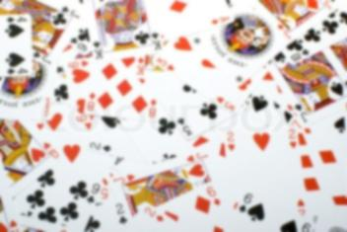
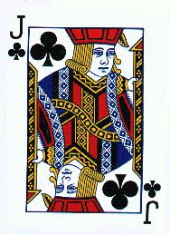
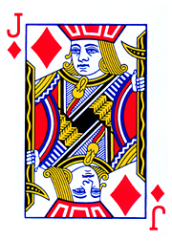
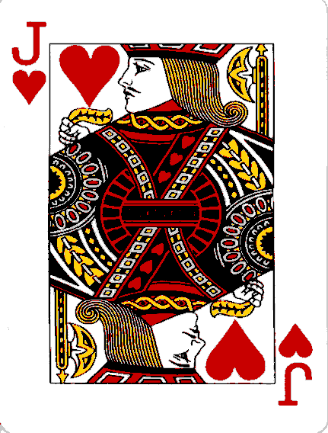
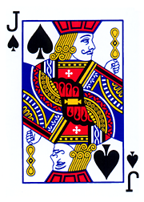
Teaching Writing:
“The Jack of All Trades”
Bri Bradfield

Slide 2

In order to get students to become passionate about any type of writing it is important to vary techniques, never forget that students can still teach the teacher, and to understand the difference between the process and the product.

Slide 3
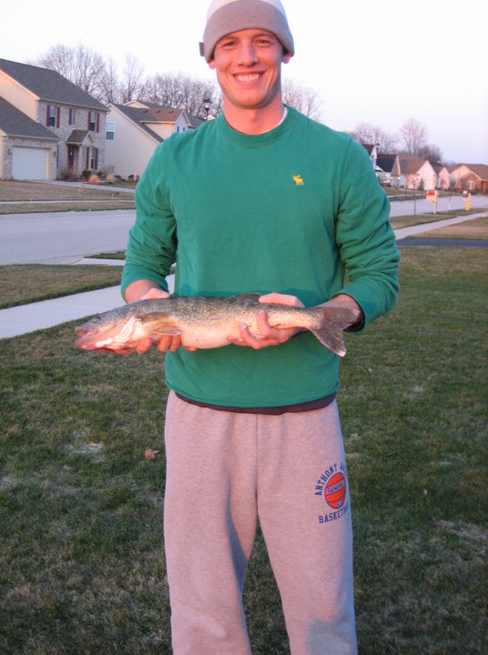
John Ernstausen
Mr. E is a sixth grade mathematics, language arts, and social studies teacher.
“I believe in an interactive and lively classroom. It is very rare to see me lecturing and my students note taking.”
“Being able to teach writing is like the jack of all trades. If you can teach a student to write you can get them to do anything that’s the biggest battle. I feel that it is my goal to get them to the point where they understand writing and want to write.”

Slide 4
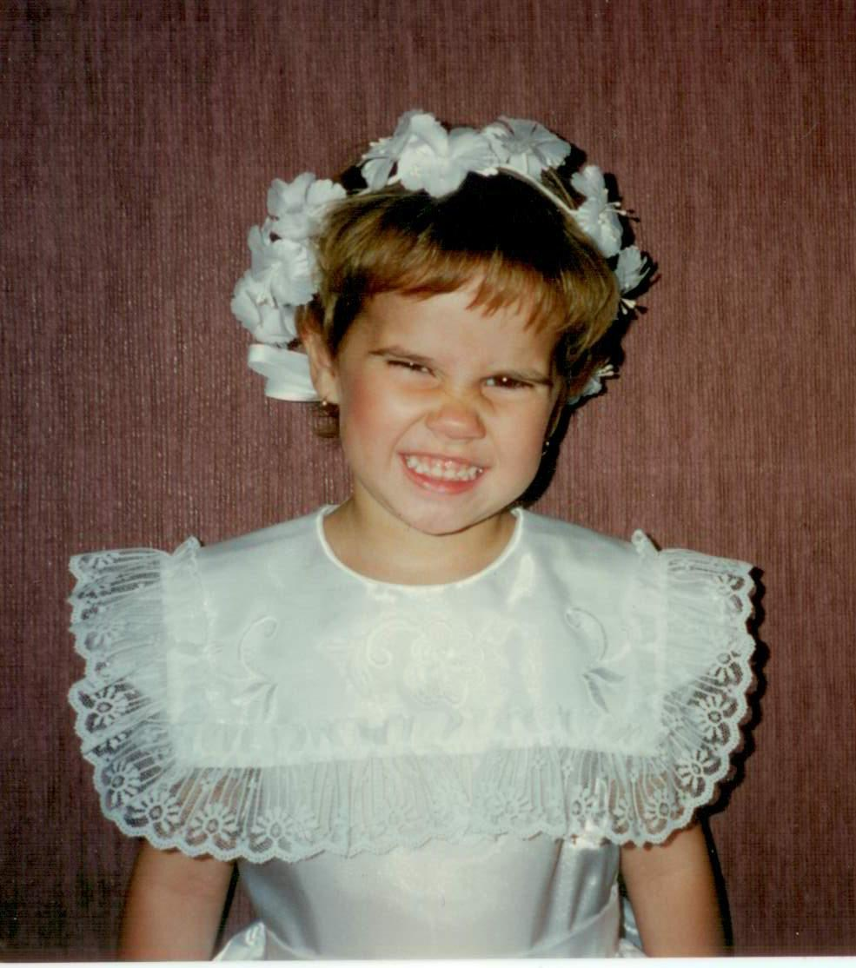
Bri Bradfield
Ideally I want to teach 4th, 6th or 8th grade. Not because they are even numbers, but I had my best experiences in those grades.
“I believe on hands-on writing. You can do more beyond the ink and paper.”
“When I become a teacher, my goal is to help students utilize writing in their everyday life. Free expression is the biggest key! I want to show them that the skill of writing goes way beyond essays and question responses. And if it does come to essays and responses I want to show them a variety of approaches.”

Slide 5


Layout
Mr. E’s responses or opinions about a question or topic will be give in this font and linked to this picture.
Bri’s questions will be given in this font and linked to this picture
The wrap up of the entire topic will be given here. This expresses feelings, opinions, and facts.

Slide 6
A Blast From the Past
“Let’s just say my parents had no say in my writing, ha. I would have to say my peers and Mrs. Krouse.”
“First off I hated Mrs. Krouse’s class it was the worst. She lectured the entire time and I already hated writing, but my buddies made it better. Even though her techniques were horrible my buddy and I were always competing. By competing with my buddy to mess with this teacher I made myself a better writer.”
“Who has had the most impact on your writing?
Good or Bad Teachers? Peers? Parents?”
People love or hate writing for certain reasons. They can
either build and learn from those reasons or they let it effect their writing.

Slide 7

What do you think of these techniques Mr. E?
LOVE THEM NO THANKS
Lecture
Peer Discussion
Examples
Red Pen Nazi
Interactive Games
Red Pen Nazi Study

Slide 8
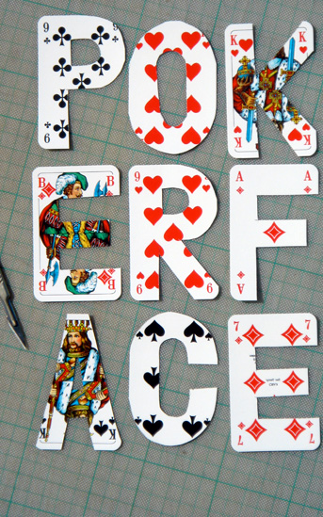
“Poker Face”
“That is first day of school business. You have to put on the hard front so to speak and wear your poker face. You have to let them think you are hard as rock, but then once you earn their respect and they earn yours that is when you open up and create the fun classroom. If those kids do not respect you then you have a class that is just crazy and you can not to anything to make
learning fun and interactive because you spend most of your time correcting your students. Four words: Poker Face and Time Management.”
Many teachers pride themselves
in being the fun teacher, but
before you have fun there has to
be an understanding of respect.
“How do you earn the
respect of your students
when having a “fun”
writing classroom?”

Slide 9

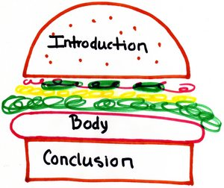
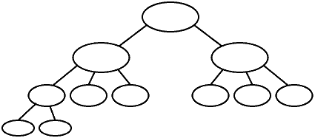
What Mr. E Has Up His Sleeve
“
What are your most successful techniques for teaching writing?
Hamburger Model of Writing
Web Clusters

Slide 10
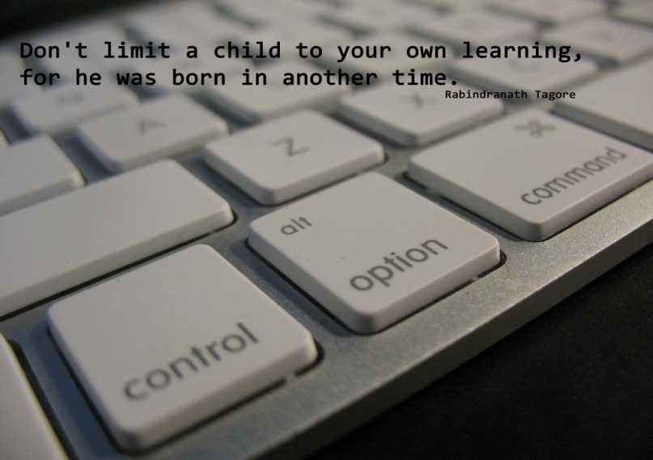
“The secret hidden in the deck”:
Technology
“
“Technology is inevitable. As we evolve so does technology and in this day age technology plays an important role in the classroom especially with writing. My students are always up on what is new so I always have them show me the new “it item.” They get excited to teach me and after I learn I try to incorporate it into my lessons. I would have to say using technology is my secret weapon in keeping my students engaged, it is what they know It makes it interesting.”
You cannot fight this tech-crazy
generation, but one should never
forget the value of a pen and
paper. Every morning Mr. E has
his students write in their journals.
You cannot always carry a
keyboard around with you.

Slide 11

Upping The Ante
“How do you plan on
keeping things fresh?
Will you keep using the
same techniques?
You always have to plan
as teaching you are
always planning. With
writing you have to evolve
techniques and sometimes
that includes lecturing,
but try as much as you
can to be interactive. Also
while planning for future
writing remember to vary
techniques for every
learner and situation.
“
“I admit I use the same techniques from year to year
but I keep them interesting. I focus on free expression
and find hands on activities to intertwine into my lessons.
I always think of ideas for the future. You have to stay on
your toes!”

Slide 12
When the Game is Over
Remember to be flexible with each student and adapt to each style
Writing is a skill and it is our job as teachers to help students develop this skill and evolve it overtime
Technique is the most important thing, how you teach writing determines how students will learn
If I could ask Mr. E a more in depth question it would be in regards to developing the thesis statement.

